Slide 1
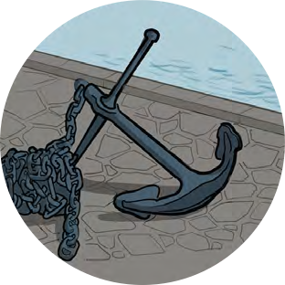
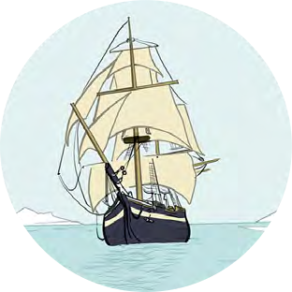
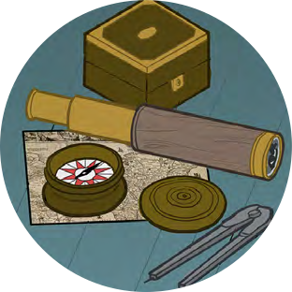
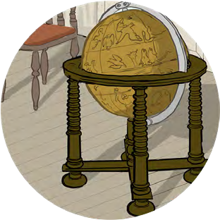
Black Tudors and the sea
Using historical sources to find out about the past
Mystery objects and images

Slide 2
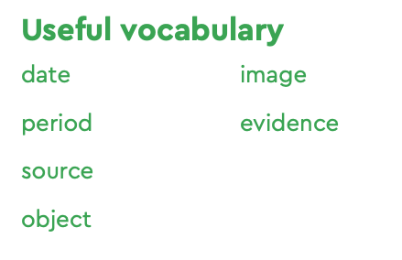
Mystery objects and images
Look closely at the images and objects on these slides
What or who could they be?
What do they tell us about Tudor life?
There is not just one right answer and any answer can be right, as long as you can be back it up with ‘evidence’ from what you can see and explain WHY you think that.

Slide 3
Mystery objects and images
You can record your findings under the following headings:
I can see… (what can you tell by looking at the object?)
I know… (what knowledge do you already have about what you can see?)
I wonder… (now you have looked at it what questions would you like to ask?)

Slide 4
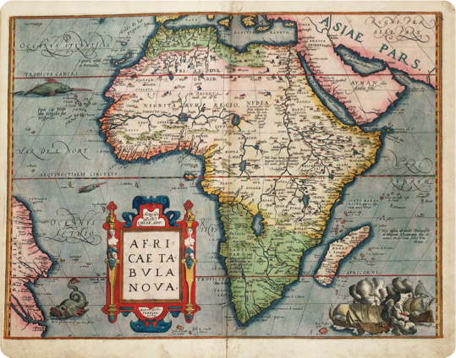
Map of Africa
Africae Tabula Nova
(A new map of Africa) (1570)
Abraham Ortelius
National Maritime Museum, Greenwich, London: PBD7640(4)
I can see…
I know…
I wonder…

Slide 5
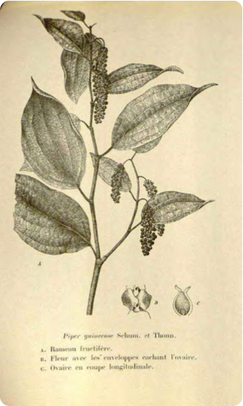
Benin Pepper
Piper guineense, (Benin pepper)
J.Fleishmann
Public domain
I can see…
I know…
I wonder…

Slide 6
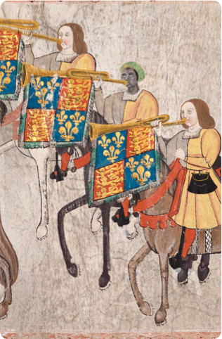
John Blanke
Detail from the Westminster Tournament Roll (1511)
College of Arms MS Westminster Tournament Roll.
Reproduced by permission of the Kings, Heralds and Pursuivants of Arms.
I can see…
I know…
I wonder…

Slide 7
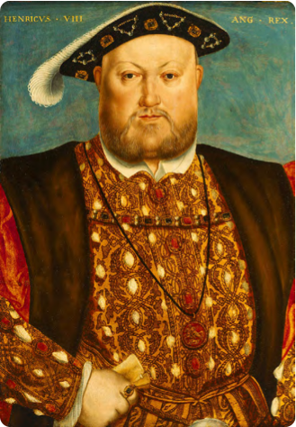
Henry VIII
Henry VIII, 1451–1547
Studio of Hans Holbein (c.1535) National Maritime Museum, Greenwich, London, Caird Collection: BHC2763
I can see…
I know…
I wonder…

Slide 8
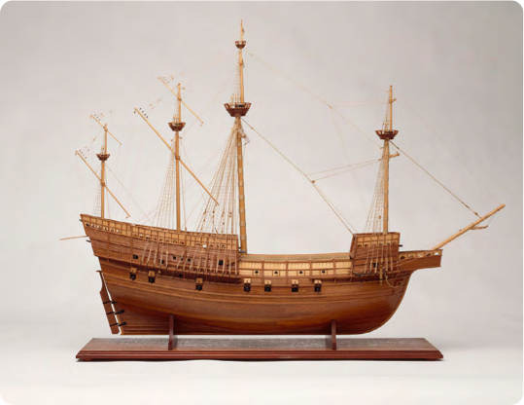
Model of the Mary Rose
Model of the Mary Rose, 1509; a 60 gun warship
National Maritime Museum, Greenwich, London: SLR3012
I can see…
I know…
I wonder…

Slide 9
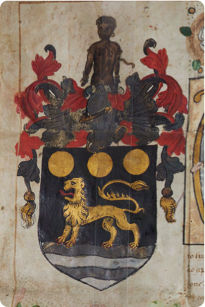
Coat of arms for Sir John Hawkins
Coat of Arms for Sir John Hawkins (1568)
The North Devon Record Office and The North Devon Athenaeum
I can see…
I know…
I wonder…

Slide 10
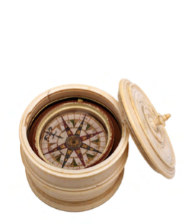
Mariner’s Compass
Mariner’s compass (c.1570)
National Maritime Museum, Greenwich, London, Caird fund: NAV0276
I can see…
I know…
I wonder…

Slide 11
Mystery objects and images
What were your findings?
What did you know about the objects?
What did you see?
What do you want to find out now?

