Slide 1
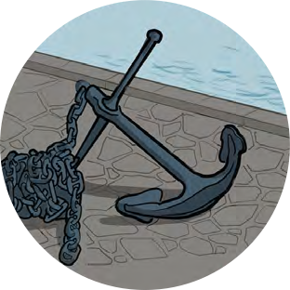
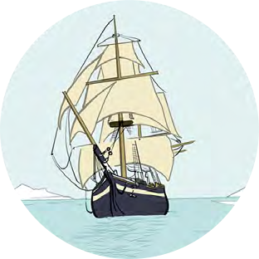
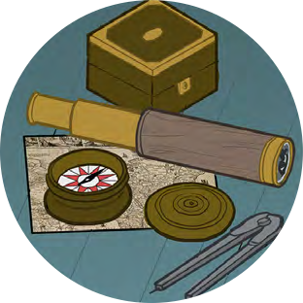
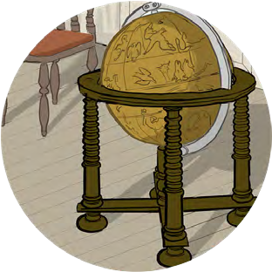
Black Tudors and the sea
Using historical sources to find out about the past
Mystery Portraits

Slide 2
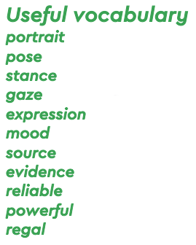
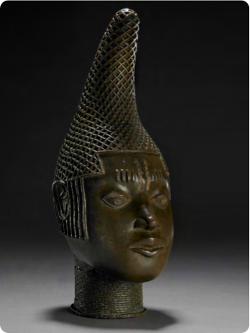
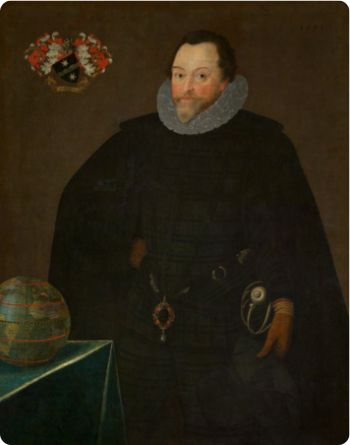
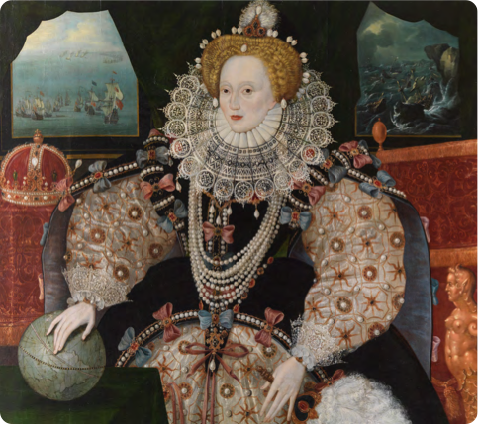
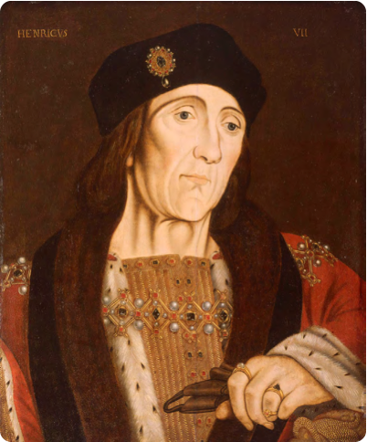
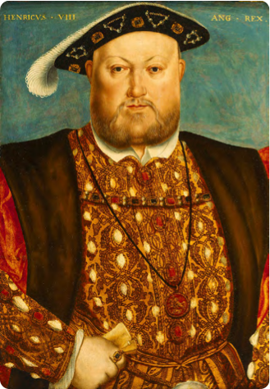
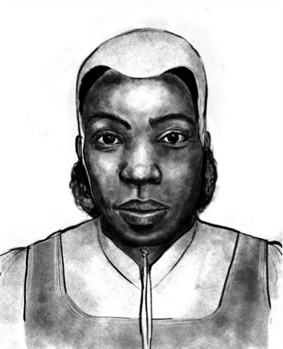
Mystery Portraits
We are going to investigate portraits (pictures or objects representing people) and use them as a tool to learn about people and their lives

Slide 3
Mystery Portraits
Choose a portrait to examine. What can you learn from it?
Use these steps to investigate and learn from a portrait. Pick one of the portraits from the resource to practice on first.
First glance
What are the first things you notice looking at the person in the portrait?
Are they…
young or old?
a man or a woman?
rich or poor?
Was there anything else you noticed straight away?

Slide 4
Mystery Portraits
Portraits are very useful to people learning about the past, if we ask the right questions
Looking Deeper
What questions could you ask about your portrait?
Pick three and use them to investigate your portrait or come up with your own
How has the artwork been made?
What message is the portrait giving you about this person?
Do you think the portrait shows what this person was actually like?
What can you see in the rest of the picture and why is it there?
What colours have been used? What effect does this have on what you think about this person?
Are they sitting, standing, crouching? Do they look relaxed or formal?
Expression – where is the person looking, what might they be thinking, feeling, doing?

Slide 5
Mystery objects and images
Putting it all together – Look at your first glance and looking deeper information.
What have you learned about these people from their portraits?

Slide 6
Commemorative head of Queen Mother ‘Idia’
First Glance….
Edo people c.1500
©The Trustees of the British Museum
Looking Deeper….

Slide 7
Francis Drake
Sir Francis Drake, 1540–96
by Marcus Gheeraerts, 1591
National Maritime Museum, Greenwich, London, Caird collection: BHC2662
First Glance….
Looking Deeper….

Slide 8
Queen Elizabeth I
Elizabeth I, the Armada Portrait
c.1588 National Maritime Museum, Greenwich, London. Acquired with the support of the Heritage Lottery Fund, Art Fund, Linbury Trust, Garfield Weston Foundation, Headley Trust and other major donors, together with contributions from over 8000 members of the public following a joint appeal with Art Fund.
First Glance….
Looking Deeper….

Slide 9
King Henry VII
Portrait of Henry VII
Studio of Hans Holbein (c.1505) National Maritime Museum, Greenwich, London, Caird collection: BHC2762
First Glance….
Looking Deeper….

Slide 10
Henry VIII
Henry VIII, 1451–1547
Studio of Hans Holbein (c.1535) National Maritime Museum, Greenwich, London, Caird Collection: BHC2763
First Glance….
Looking Deeper….

Slide 11
Cattelena of Almondsbury
First Glance….
Illustration by Shaun Campbell, 2021
Looking Deeper….

