Slide 1
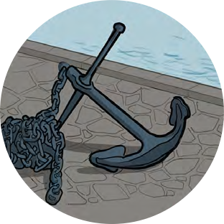
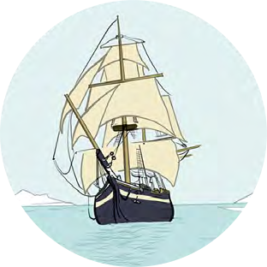
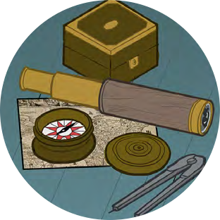
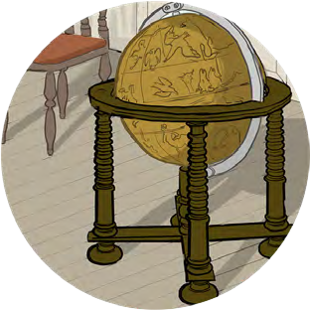
Black Tudors and the sea
Developing Empathy
Empathy Maps

Slide 2
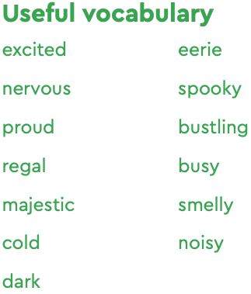
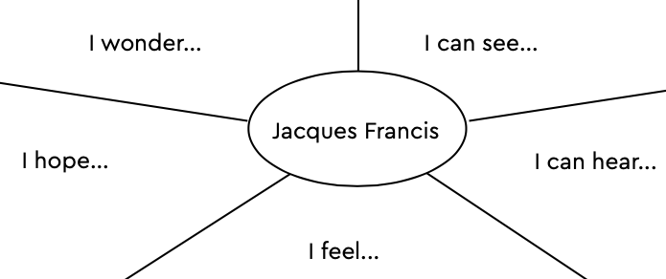
Empathy Maps
We can use our imagination to try and understand what people in the past experienced using pictures and objects
Use the grid below to think about what the people in these pictures was experiencing
If you are looking at an object how would the people using it feel?

Slide 3
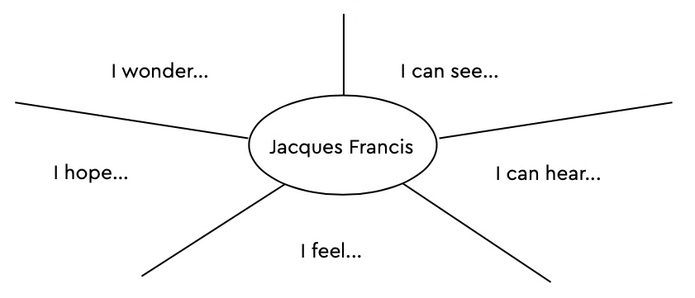
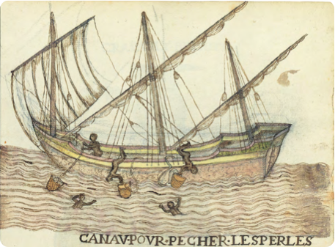
Empathy Maps
Can you use the map to think about what it would have been like to be a pearl diver like Jacques Francis?
Canav Pour Pecher Les Perles (Canoe for Pearl-Fishing)
Histoire naturelle des Indes : manuscript, ca. 1586., fol. 59 recto. ca. 1586. The Morgan Library & Museum. MA 3900. Bequest of Clara S. Peck, 1983.

Slide 4
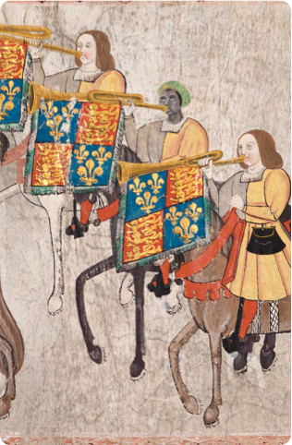
John Blanke
Detail from the Westminster Tournament Roll (1511)
College of Arms MS Westminster Tournament Roll.
Reproduced by permission of the Kings, Heralds and Pursuivants of Arms.

Slide 5
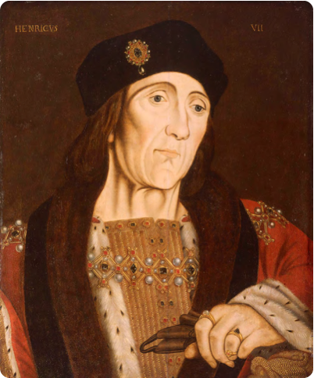
King Henry VII
Portrait of Henry VII
Studio of Hans Holbein (c.1505) National Maritime Museum, Greenwich, London, Caird collection: BHC2762

Slide 6
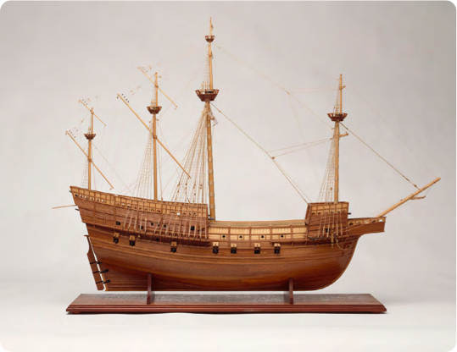
Model of the Mary Rose
Model of the Mary Rose, 1509; a 60 gun warship
National Maritime Museum, Greenwich, London: SLR3012

Slide 7
Jacques Francis
Canav Pour Pecher Les Perles (Canoe for Pearl-Fishing),
Histoire naturelle des Indes : manuscript, ca. 1586., fol. 59 recto. ca. 1586. The Morgan Library & Museum. MA 3900. Bequest of Clara S. Peck, 1983.

Slide 8
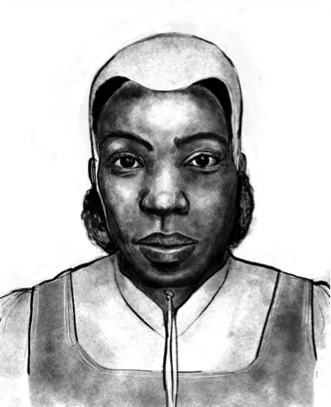
Cattelena of Almondsbury
Illustration by Shaun Campbell, 2021

