Slide 1
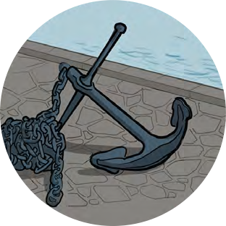
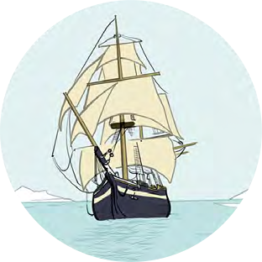
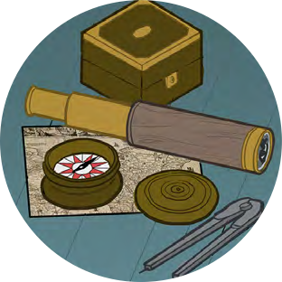
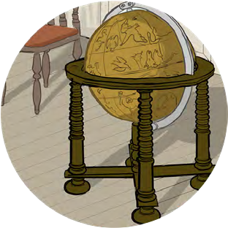
Black Tudors and the sea
Developing Empathy
Time Travelling Reporters

Slide 2
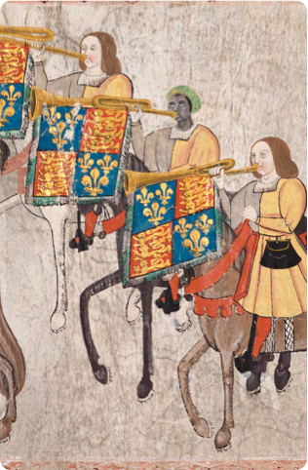
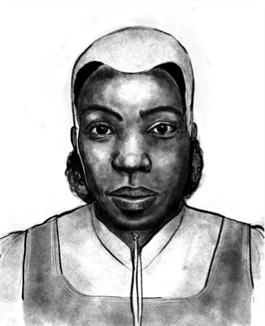
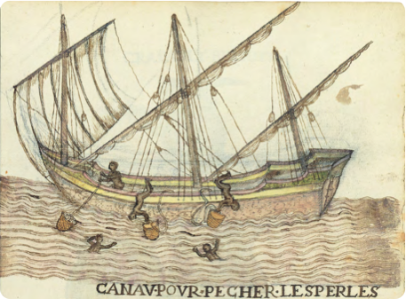
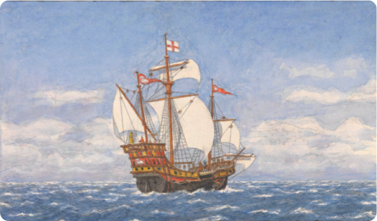
Time Travelling Reporters
John Blanke in the run up to the Westminster tournament or Henry VIII’s coronation – how is he feeling about his important role as trumpeter? Is he nervous, excited, proud, etc.?
You are reporters who can travel through time
Mission: Interview a person from the past about an event or issue from their life
Edward Francis after he has run away from the Tower of London
Catellena as she arrives in the busy port of Bristol
Diego as he sets off on the epic ‘circumnavigation’ voyage with Francis Drake – what is he most looking forward to? What does he hope they will find?
Francis Drake as he prepares for his role in defending England against the Spanish Armada
Jacques Francis as he prepares to dive down to the bottom of the sea and recover items from the Mary Rose

Slide 3
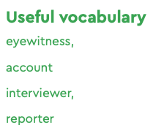
Time Travelling Reporters
Come up with 5 key questions for your interviewee to answer
Research how your interviewee would answer your questions
Optional extra – use a background and film your interview, you’ll need to practice and work out who is going to be who

Slide 4
Cattelena of Almondsbury
Illustration by Shaun Campbell, 2021

Slide 5
John Blanke
Detail from the Westminster Tournament Roll (1511)
College of Arms MS Westminster Tournament Roll.
Reproduced by permission of the Kings, Heralds and Pursuivants of Arms.

Slide 6
Jacques Francis
Canav Pour Pecher Les Perles (Canoe for Pearl-Fishing),
Histoire naturelle des Indes : manuscript, ca. 1586., fol. 59 recto. ca. 1586. The Morgan Library & Museum. MA 3900. Bequest of Clara S. Peck, 1983.

Slide 7
The Golden Hind
The Golden Hind ‘when Drake set off for the Spanish Main’ (date unknown)
by R.E Arnold
National Maritime Museum, Greenwich, London: PAF7916

Slide 8
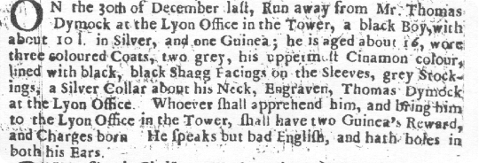
Edward Francis
Runaway from the Tower notice
London Gazette 5-7 January, 1687
TRANSCRIPT - On the 30th December last, run away from Mr Thomas Dymock at the Lion Office in the Tower, a Black boy with about 10 lbs [weight] in silver and one Guinea. He is aged about 16, wore three coloured coats, the uppermost cinnamon colour lined with black, black shag facings on the sleeves, grey stockings, a silver collar about his neck engraved Thomas Dymock at the Lion Office. Whoever shall apprehend him and bring him to the Lion Office in the Tower shall have two guineas reward and charges born. He speaks but bad English and has holes in both his ears.

