Slide 1
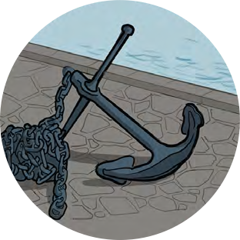
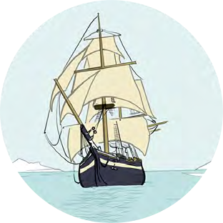
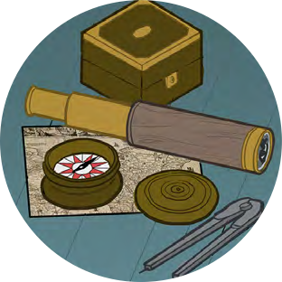
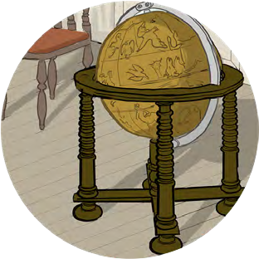
Black Tudors and the sea
Making Connections
The Kingdom of Benin and Tudor England

Slide 2
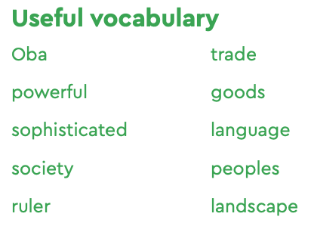
The Kingdom of Benin and Tudor England
500 years ago the Kingdoms of England and Benin first came into contact.
What were they like?
Were they similar or different as societies?
What would we need to do to find out?

Slide 3
The Kingdom of Benin and Tudor England
For each country, you could find out:
where it was in the world
whether it was a coastal or landlocked country
how the country was ruled
about the lives of rulers and of ordinary people
the kind of jobs people did
the languages spoken
the type of landscape and climate
whether it traded with other countries in the world, and what kind of goods were traded
whether it was rich or poor; powerful or weak.
Things you could use
Objects
Map of Africa
Timeline of England and Benin
Other information you can find on England and Benin including useful websites
Tudor England and Kingdom of Benin information cards

Slide 4
The Kingdom of Benin and Tudor England
Similarities | Differences

Slide 5
The Kingdom of Benin and Tudor England
Overall were these two Kingdoms similar or different?
Place yourself along this line to explain how similar or different you think they are
Completely Different
A little bit different
A little bit the same
Completely the same

Slide 6
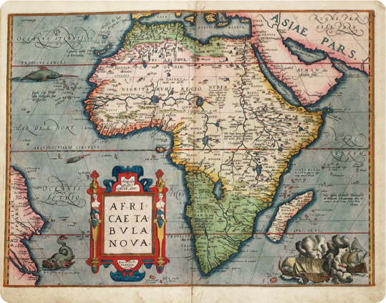
Map of Africa
Africae Tabula Nova
(A new map of Africa) (1570)
Abraham Ortelius
National Maritime Museum, Greenwich, London: PBD7640(4)

Slide 7
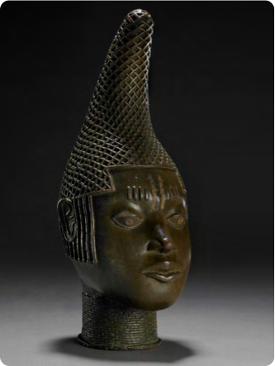
Commemorative head of Queen Mother ‘Idia’.
Commemorative Head of Queen Mother ‘Idia’ Edo people c.1500
©The Trustees of the British Museum

Slide 8
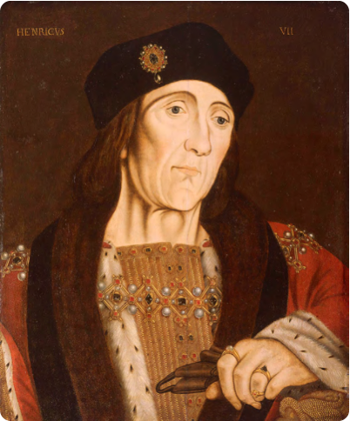
King Henry VII
Portrait of Henry VII
Studio of Hans Holbein (c.1505) National Maritime Museum, Greenwich, London, Caird collection: BHC2762

Slide 9
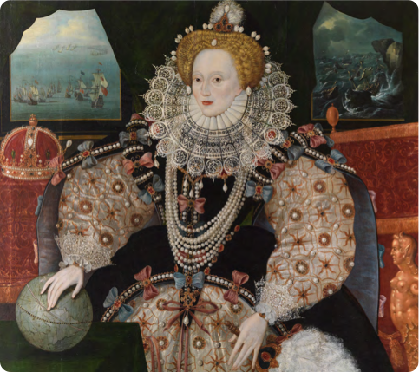
Queen Elizabeth I
Elizabeth I, the Armada Portrait
c.1588 National Maritime Museum, Greenwich, London. Acquired with the support of the Heritage Lottery Fund, Art Fund, Linbury Trust, Garfield Weston Foundation, Headley Trust and other major donors, together with contributions from over 8000 members of the public following a joint appeal with Art Fund.

