Slide 1
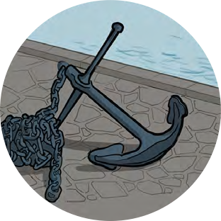
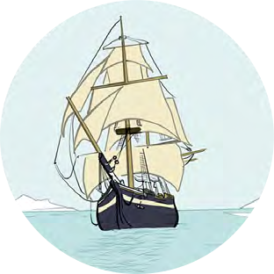
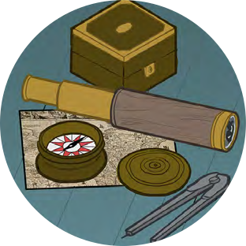
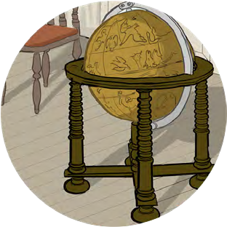
Black Tudors and the sea
Making Connections
Tudor Voyages

Slide 2
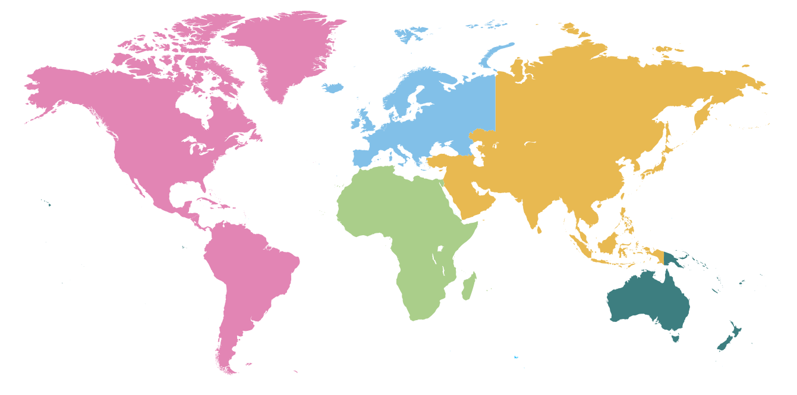
Tudor Voyages
In the Tudor period lots of sea voyages left the British isles. Some became famous. Can you follow some of these voyages on a world map?

Slide 3
Tudor Voyages
Find and mark these places onto your map:
The seven continents
The Kingdom of Benin (now southern Nigeria)
England
Plymouth
Bristol
Spain
Portugal
The Caribbean
Newfoundland

Slide 4
Tudor Voyages
Mark each of these voyages onto your map using a dotted line
John Cabot’s voyage from Bristol to what became ‘Newfoundland’ in 1497.
2. William Hawkins’ trading voyage from England to West Africa, in the 1530s, in search of ivory and pepper.
3. John Hawkins slaving voyage in 1562.
◊ He set sail from England to the coast of West Africa (Sierra Leone) where he captured 300 African men, women and children.
◊ He transported them to the Caribbean, where he sold them to plantation owners. There they were put to work as slaves, producing goods such as sugar.
◊ The goods were then shipped to Europe for sale – with huge profits.
Why do children think this terrible system was sometimes known as the ‘triangular trade’?
4. Diego and Drake’s circumnavigation voyage (1577–80). What route do children think they might have taken? Which continents would they have had to sail around?
◊ They set sail from Plymouth...
◊ ...sailing down the West Coast of Africa and across to Brazil, on the east coast of South America then sailed around Cape Horn – the southernmost tip of mainland South America – and up the west coast as far as what is now San Francisco, claiming land for Elizabeth I and then headed east towards what is now known as Indonesia, where Diego died.
◊ Drake and the surviving crew continued across the north-east coast of Australia, around the Cape of Good Hope – the southernmost tip of Africa – and back to Plymouth.

Slide 5
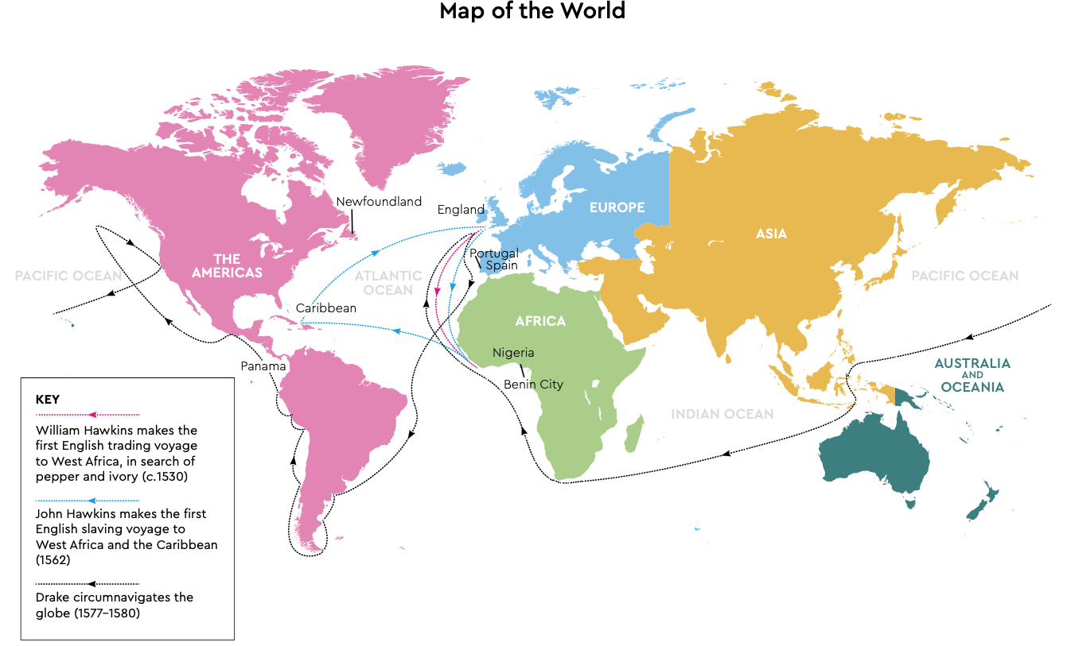
Tudor Voyages

Slide 6
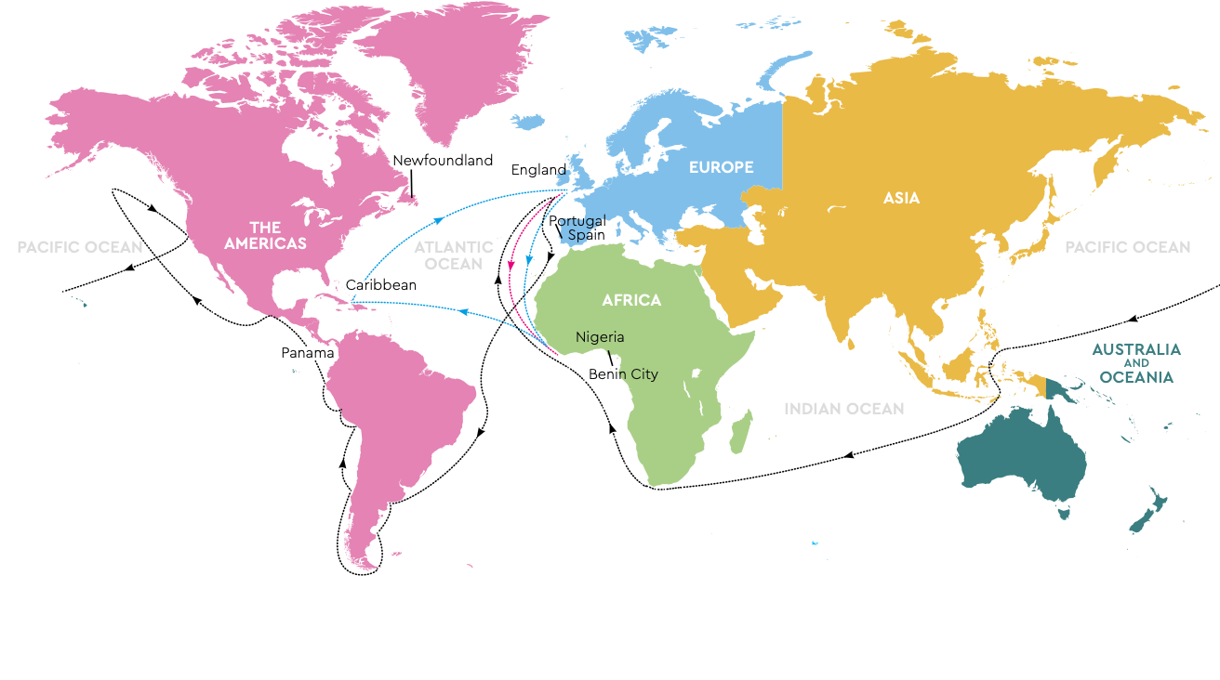
Tudor Voyages
Taking things Further:
Tudor maps like the Map of Africa were often beautifully illustrated, with sailing ships and fantastical sea creatures. Illustrate your maps.
Create a class collage of your world maps.
Thinking Deeper – Questions to discuss
What did these voyages mean for Tudor England?
How did life in Tudor England change as a result of these voyages?

Slide 7
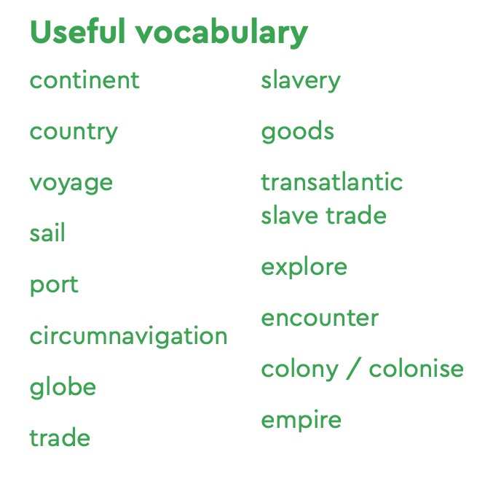
Tudor Voyages

