Slide 1
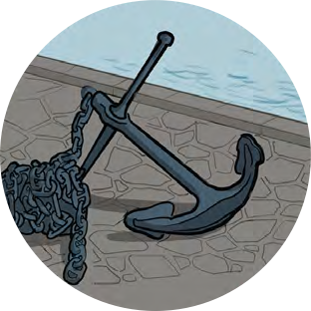
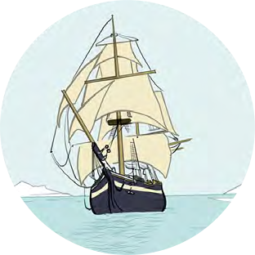
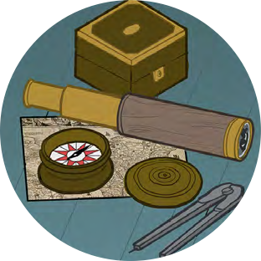
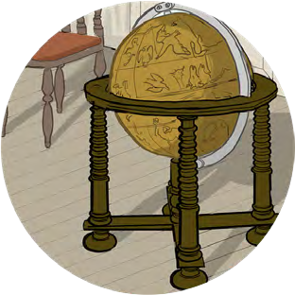
Black Tudors and the sea
Making Connections
Traders

Slide 2
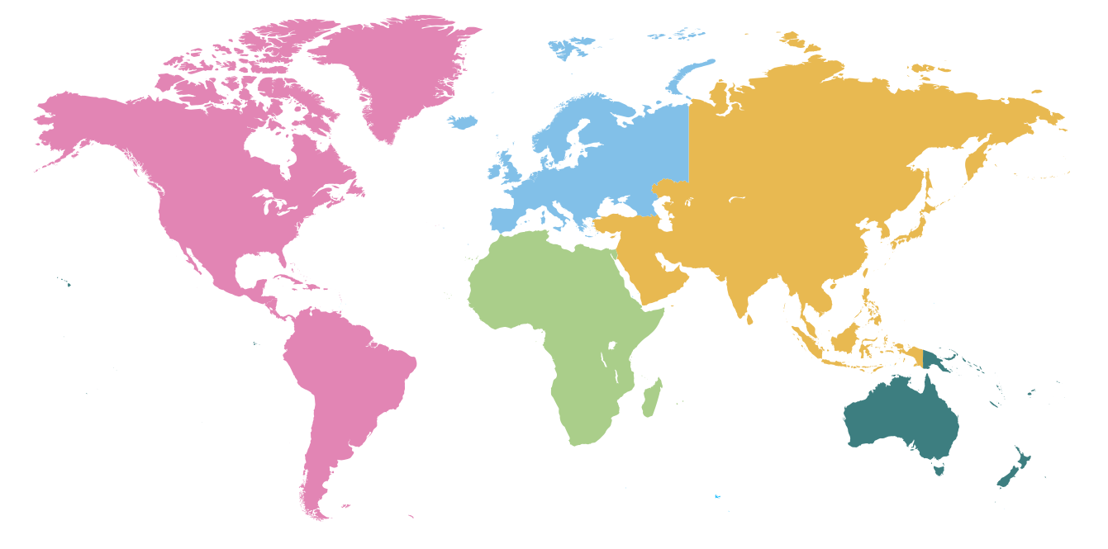
Traders
Where do the things you use come from?
Think of five different things that you use as part of your every day lives.
Do you know where they came from?
How many did you know and how many did you not?

Slide 3
For your five objects…
Research to find out where they come from and how they are made.
Plot this onto your map
Pick one thing and find out more
Find out as much as you can about its journey from growing or being made into the finished object
Make a diagram showing all the stages involved in making this
Traders

Slide 4
Traders
Thinking Deeper:
Are you surprised at where the goods come from or are made?
Why do they think they are produced there?
What are the jobs of the people involved?
Are they all treated fairly?
Is it important that trade is fair to everyone involved?

