Slide 1
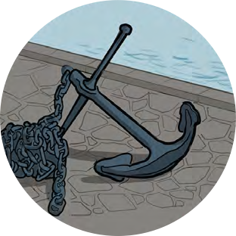
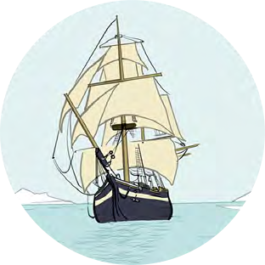
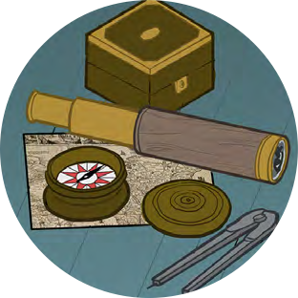
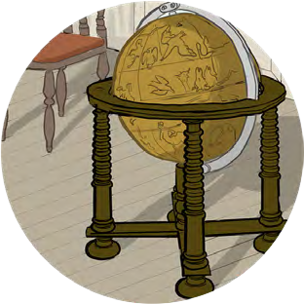
Black Tudors and the sea
Making Connections
Views of Africa

Slide 2
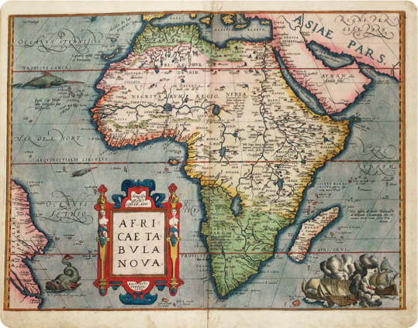
Views of Africa
Challenge – Can you find a modern map of Africa?
Is there one anywhere in your classroom or school?
How is it different to this map of Africa made by Europeans in the Tudor period?

Slide 3
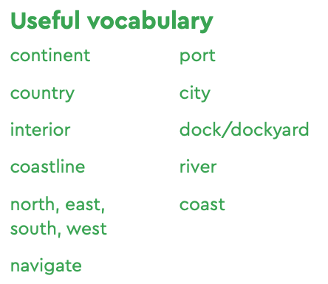
Views of Africa
Africa was, and still is, a continent made up of many different countries and peoples, speaking hundreds of different languages. We can use objects like maps to investigate places but also what the people who made the maps thought and knew about them.
What is the same and what is different?
How many different countries can children spot on the modern map?
How many different nations can they spot on the Tudor map?
The Kingdom of Benin was situated in what is now southern Nigeria. Do you know anyone who lives in or comes from Nigeria? Has anyone ever been there?
Do they think the Tudor map of Africa is accurate?

Slide 4
Views of Africa
Discussion questions:
What misconceptions do you think people have about Africa?
Where do you think these ideas might have come from?
Keyword – Misconception
a view or opinion that is incorrect and is based on mistaken thinking or misunderstanding

Slide 5
Map of Africa
Africae Tabula Nova
(A new map of Africa) (1570)
Abraham Ortelius
National Maritime Museum, Greenwich, London: PBD7640(4)

