Slide 1
Sample social story for schools
You can use this social story to help young people transition before and during a visit to Cutty Sark.
The slides give multiple examples of activities and spaces you may visit. Feel free to alter this presentation to suit your specific visit.
From time to time our galleries need to undergo maintenance and we regularly offerings. If there is a particular part of the ship you are planning to visit and you would like an up-to-date image, please contact our Learning team (learning@rmg.co.uk) who can provide assistance.

Slide 2
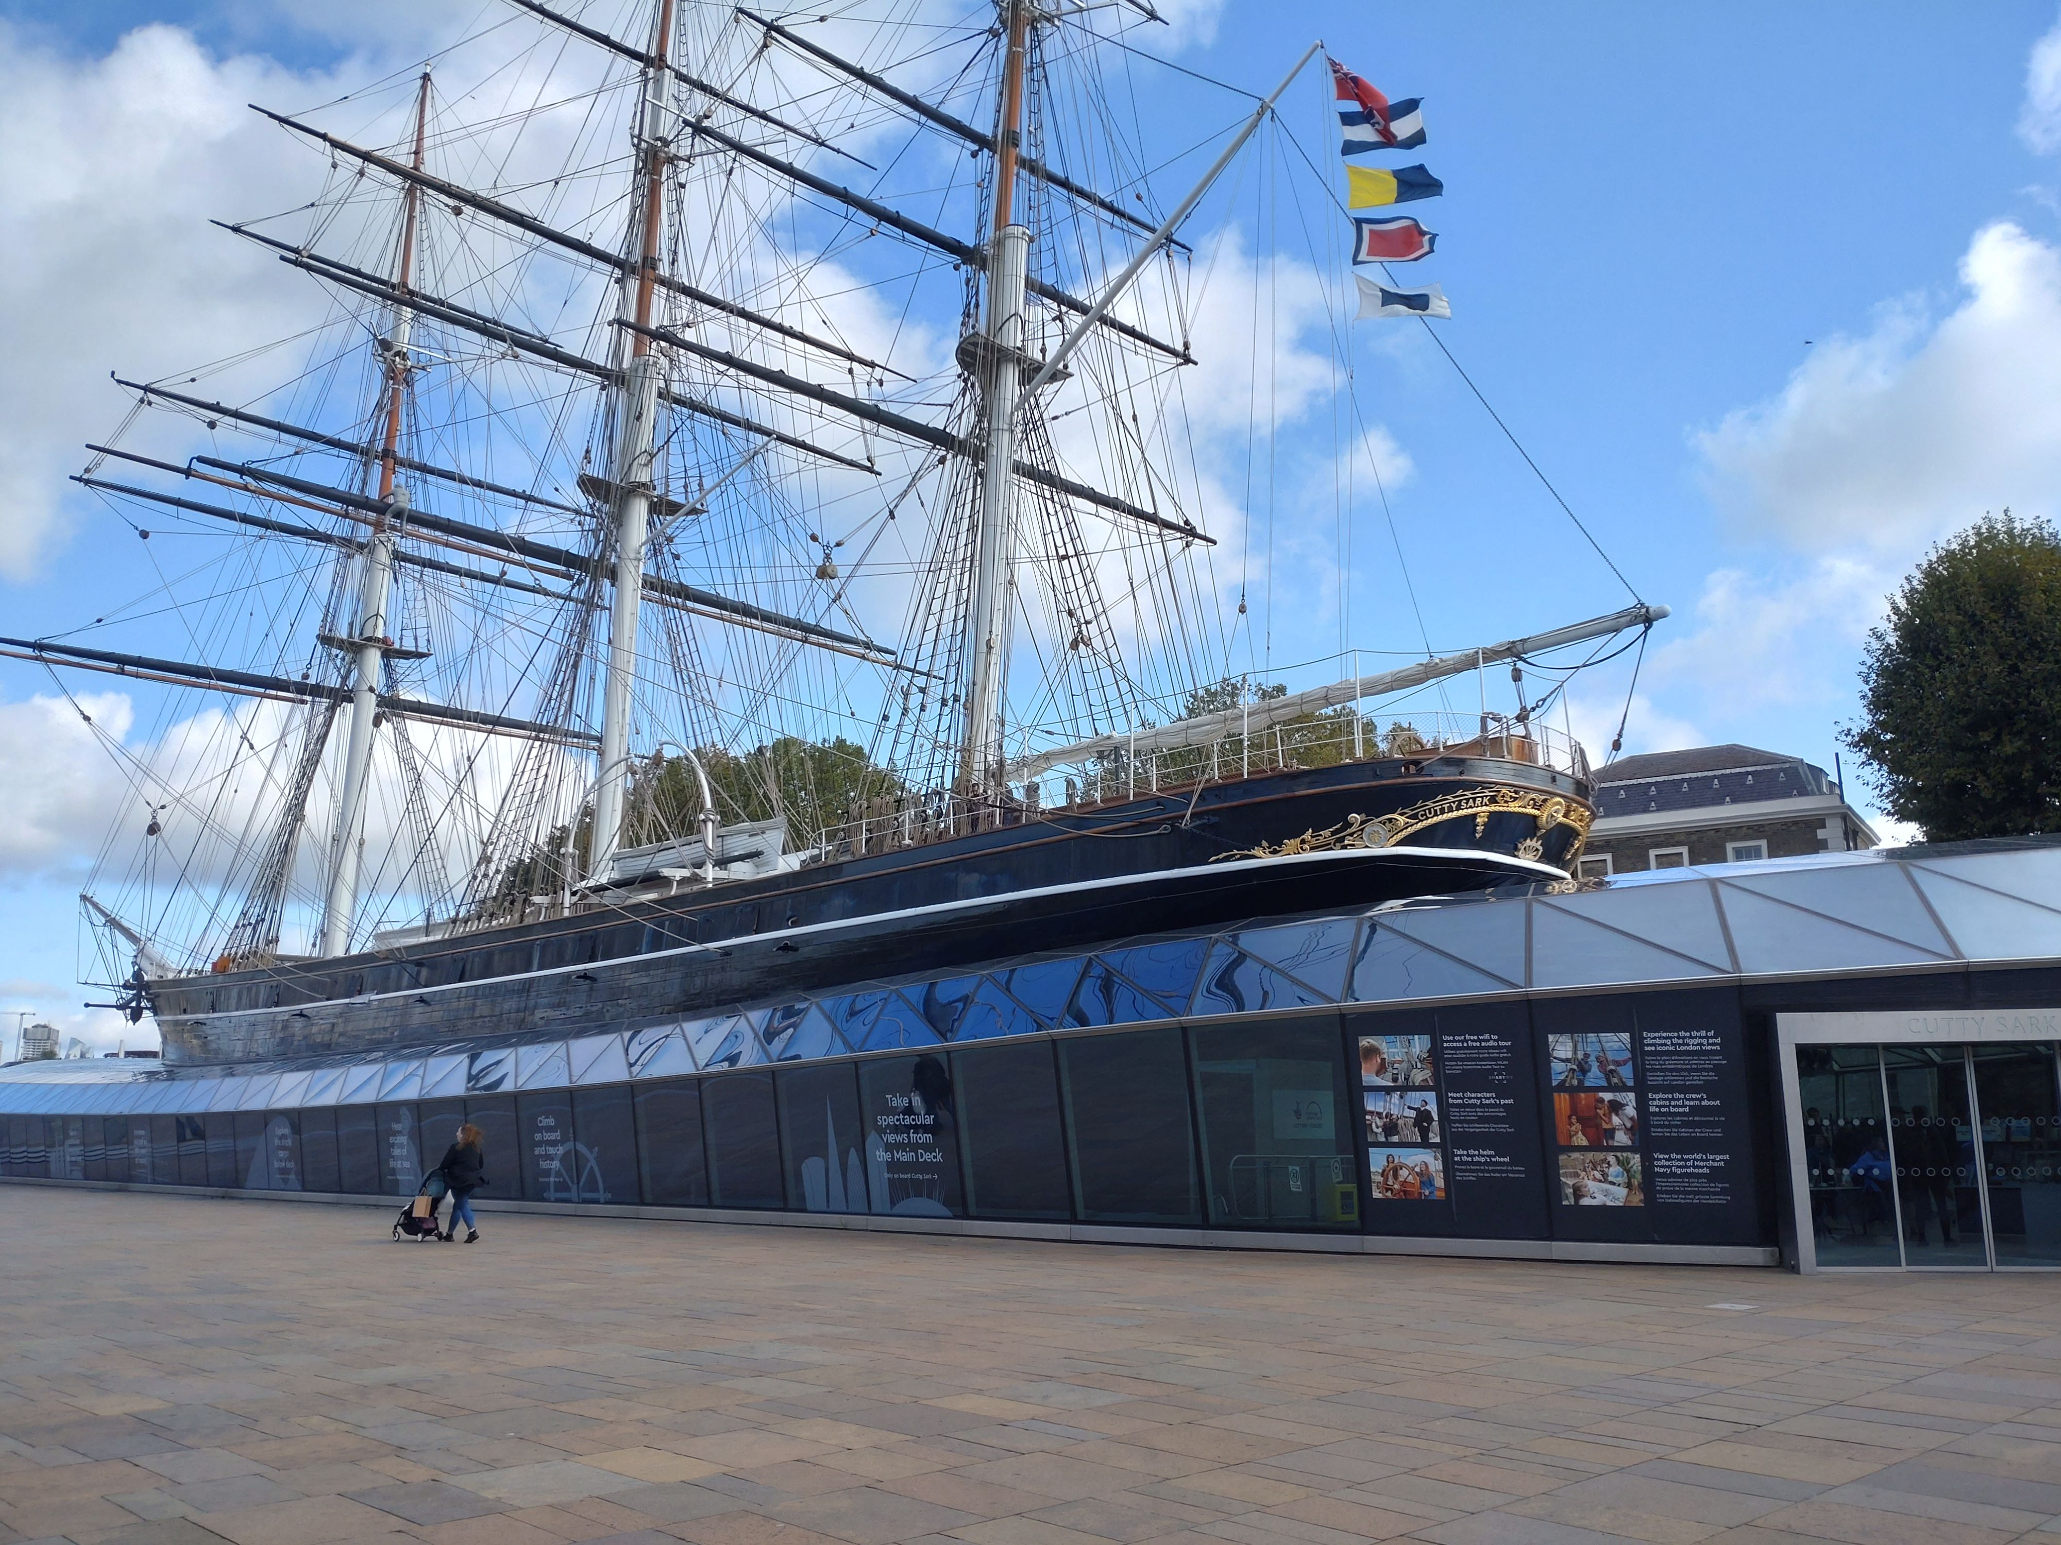
The Cutty Sark is an old sailing ship in Greenwich, next to the River Thames

Slide 3
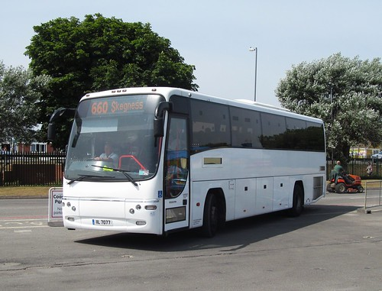
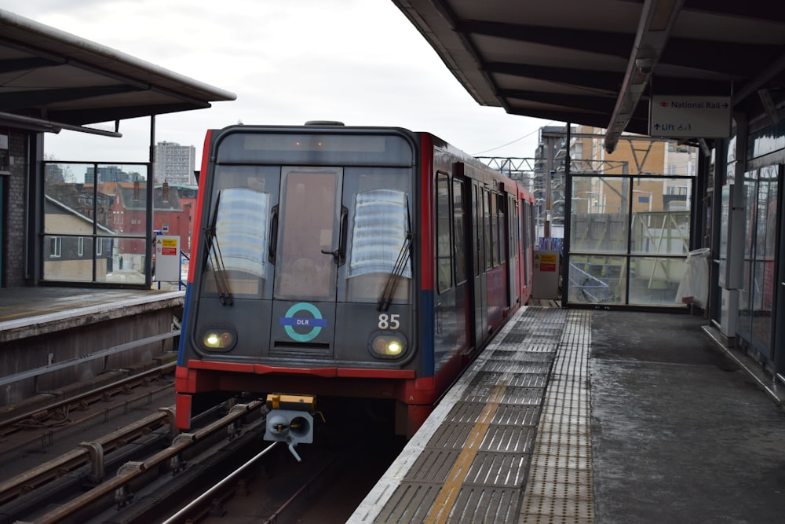
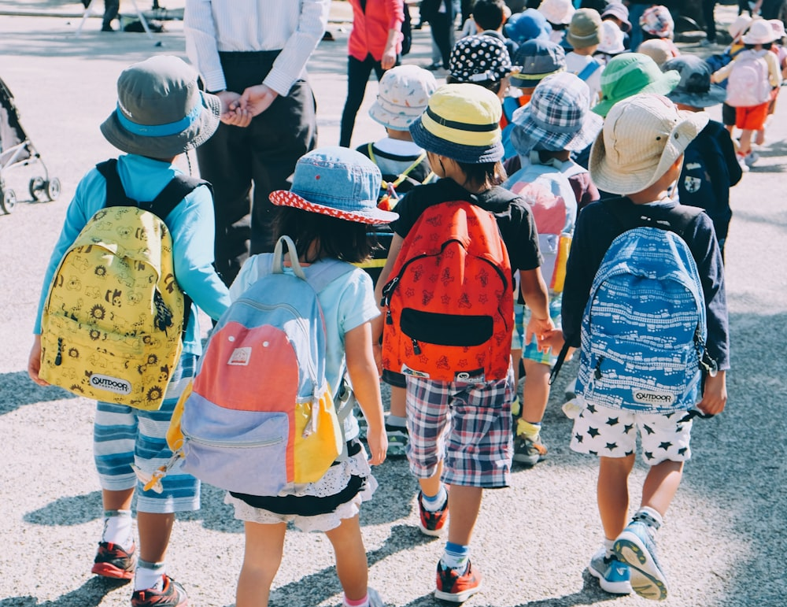
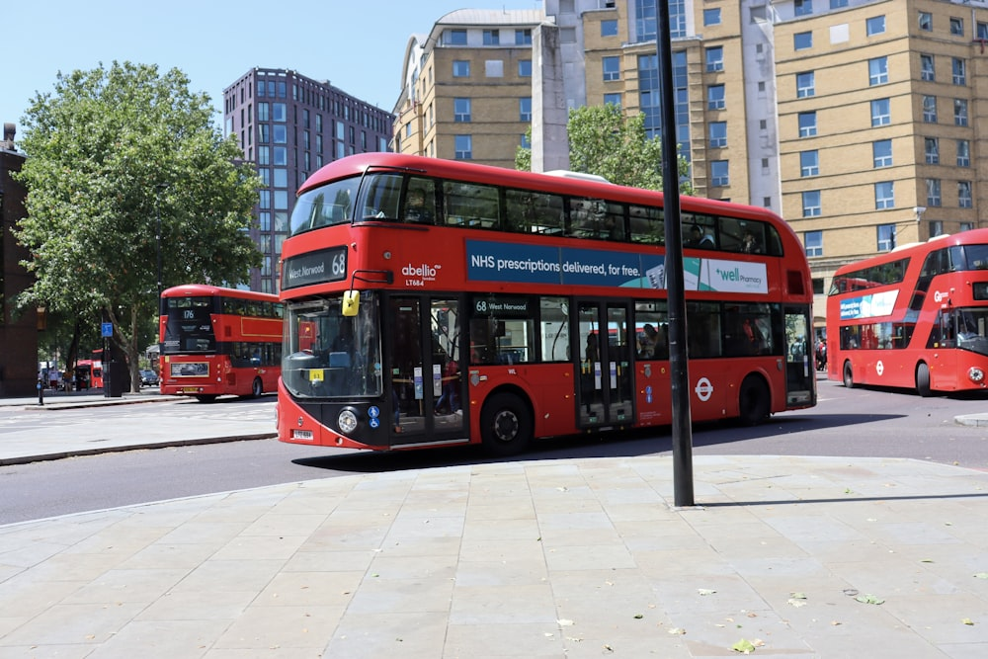
We are going on buses / on the train / on the bus / we are walking
Notes:
Edit this slide to include your method of transport

Slide 4
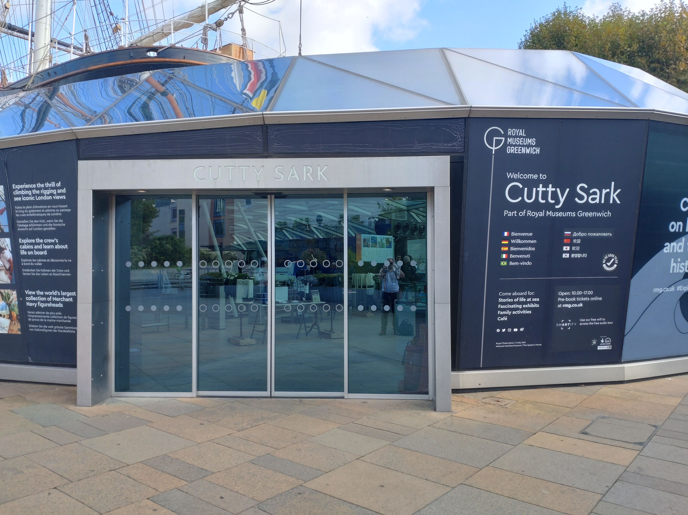
This is the entrance to the ship

Slide 5
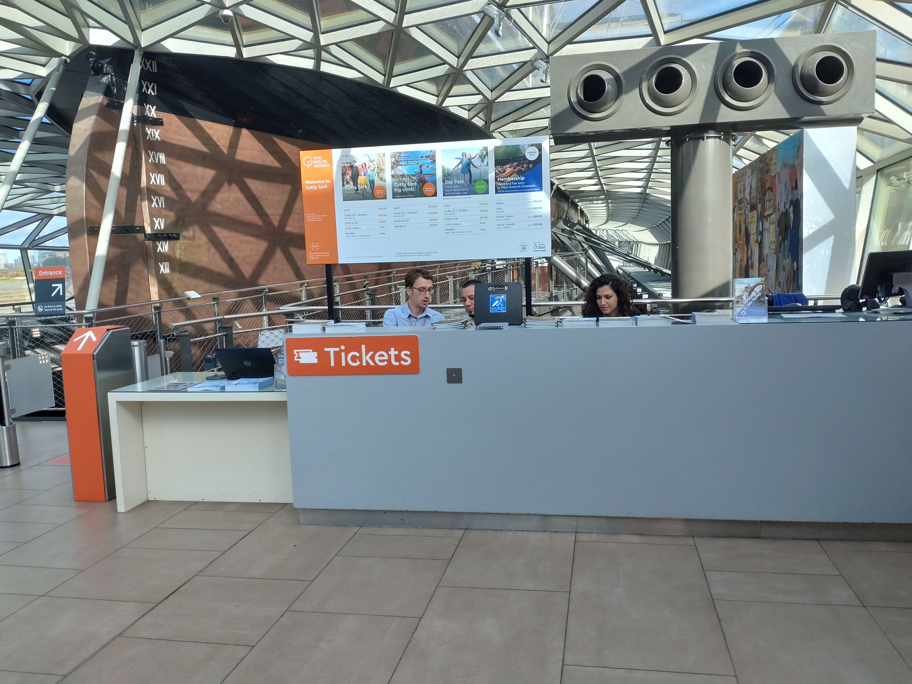
This is the ticket desk

Slide 6
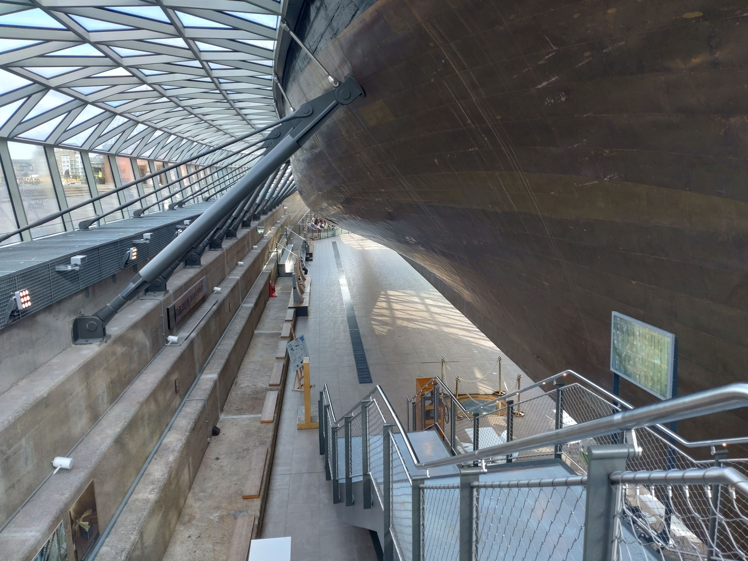
You will go down to the dry dock to put your things away

Slide 7
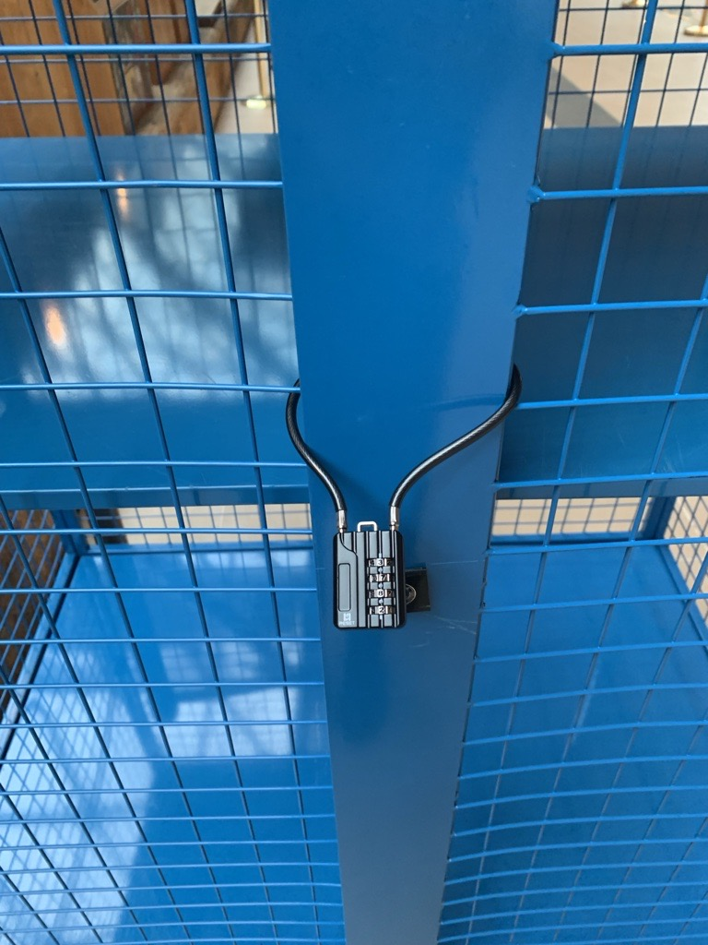
You will leave your things in a blue trolley

Slide 8
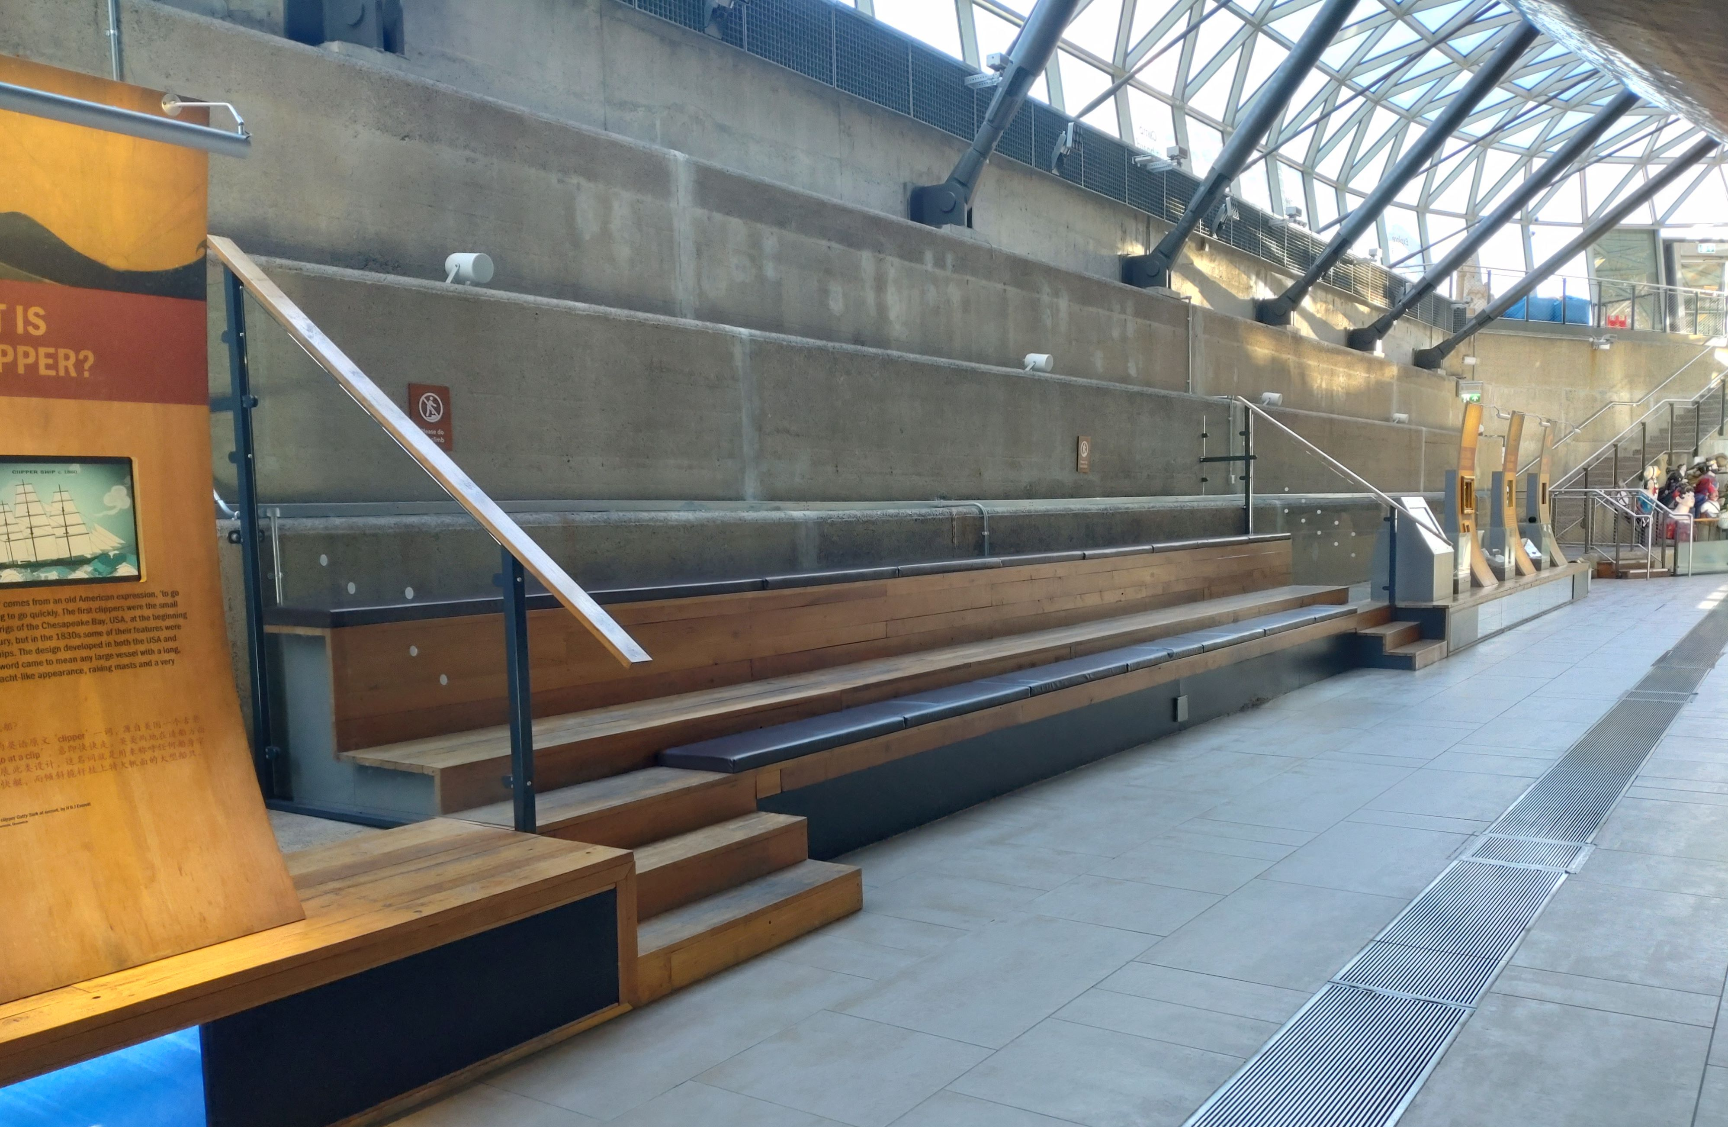
You will sit on these benches and hear more about the activities that you are going to take part in

Slide 9
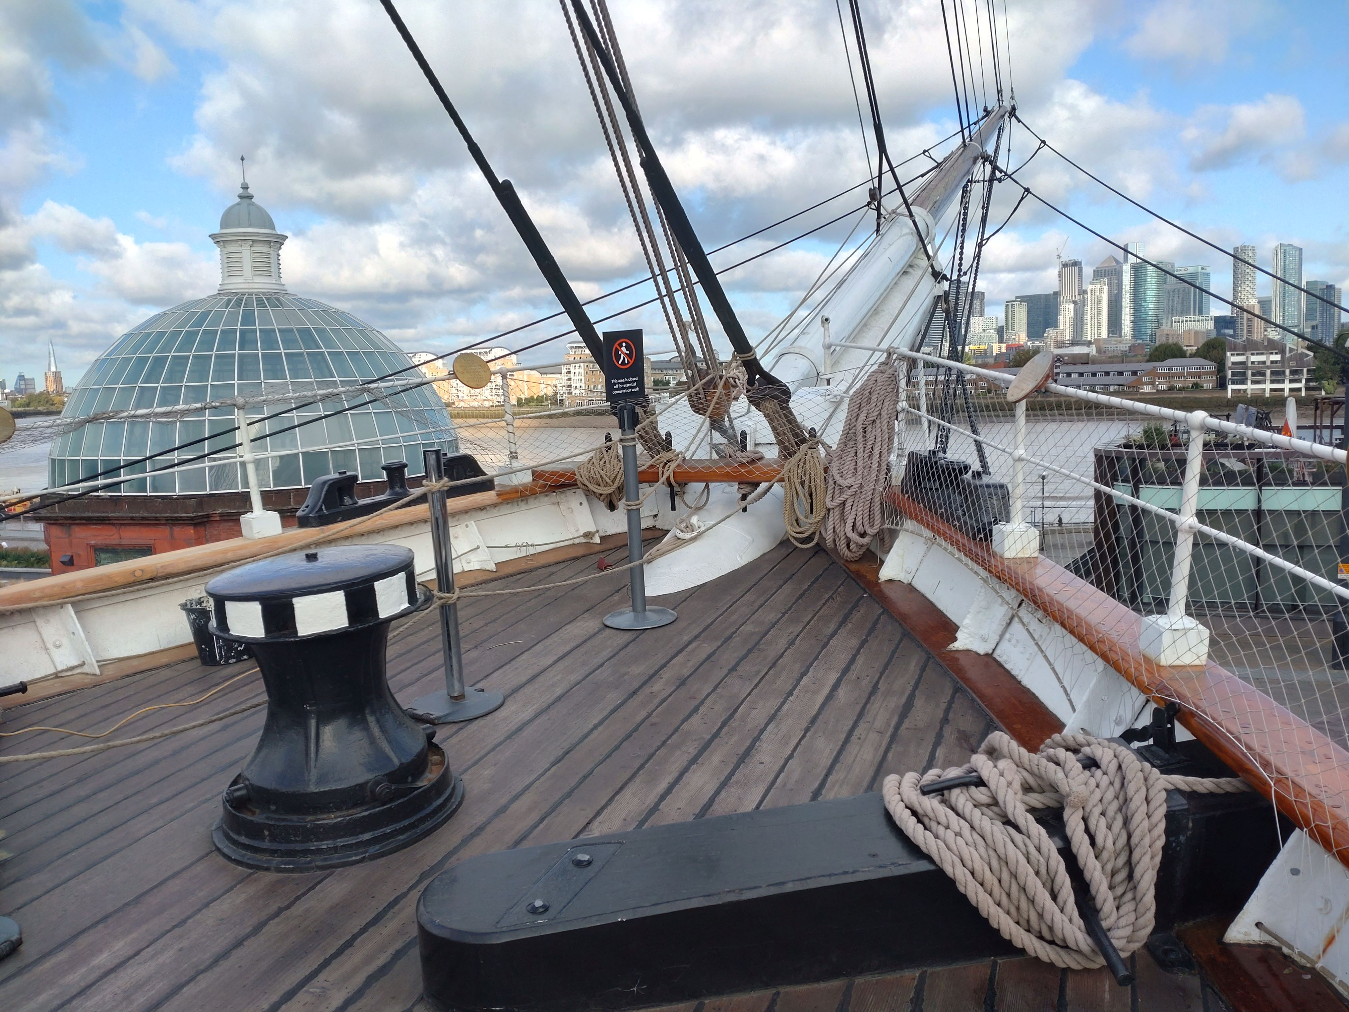
You will go to the Main Deck
You can look at the view

Slide 10
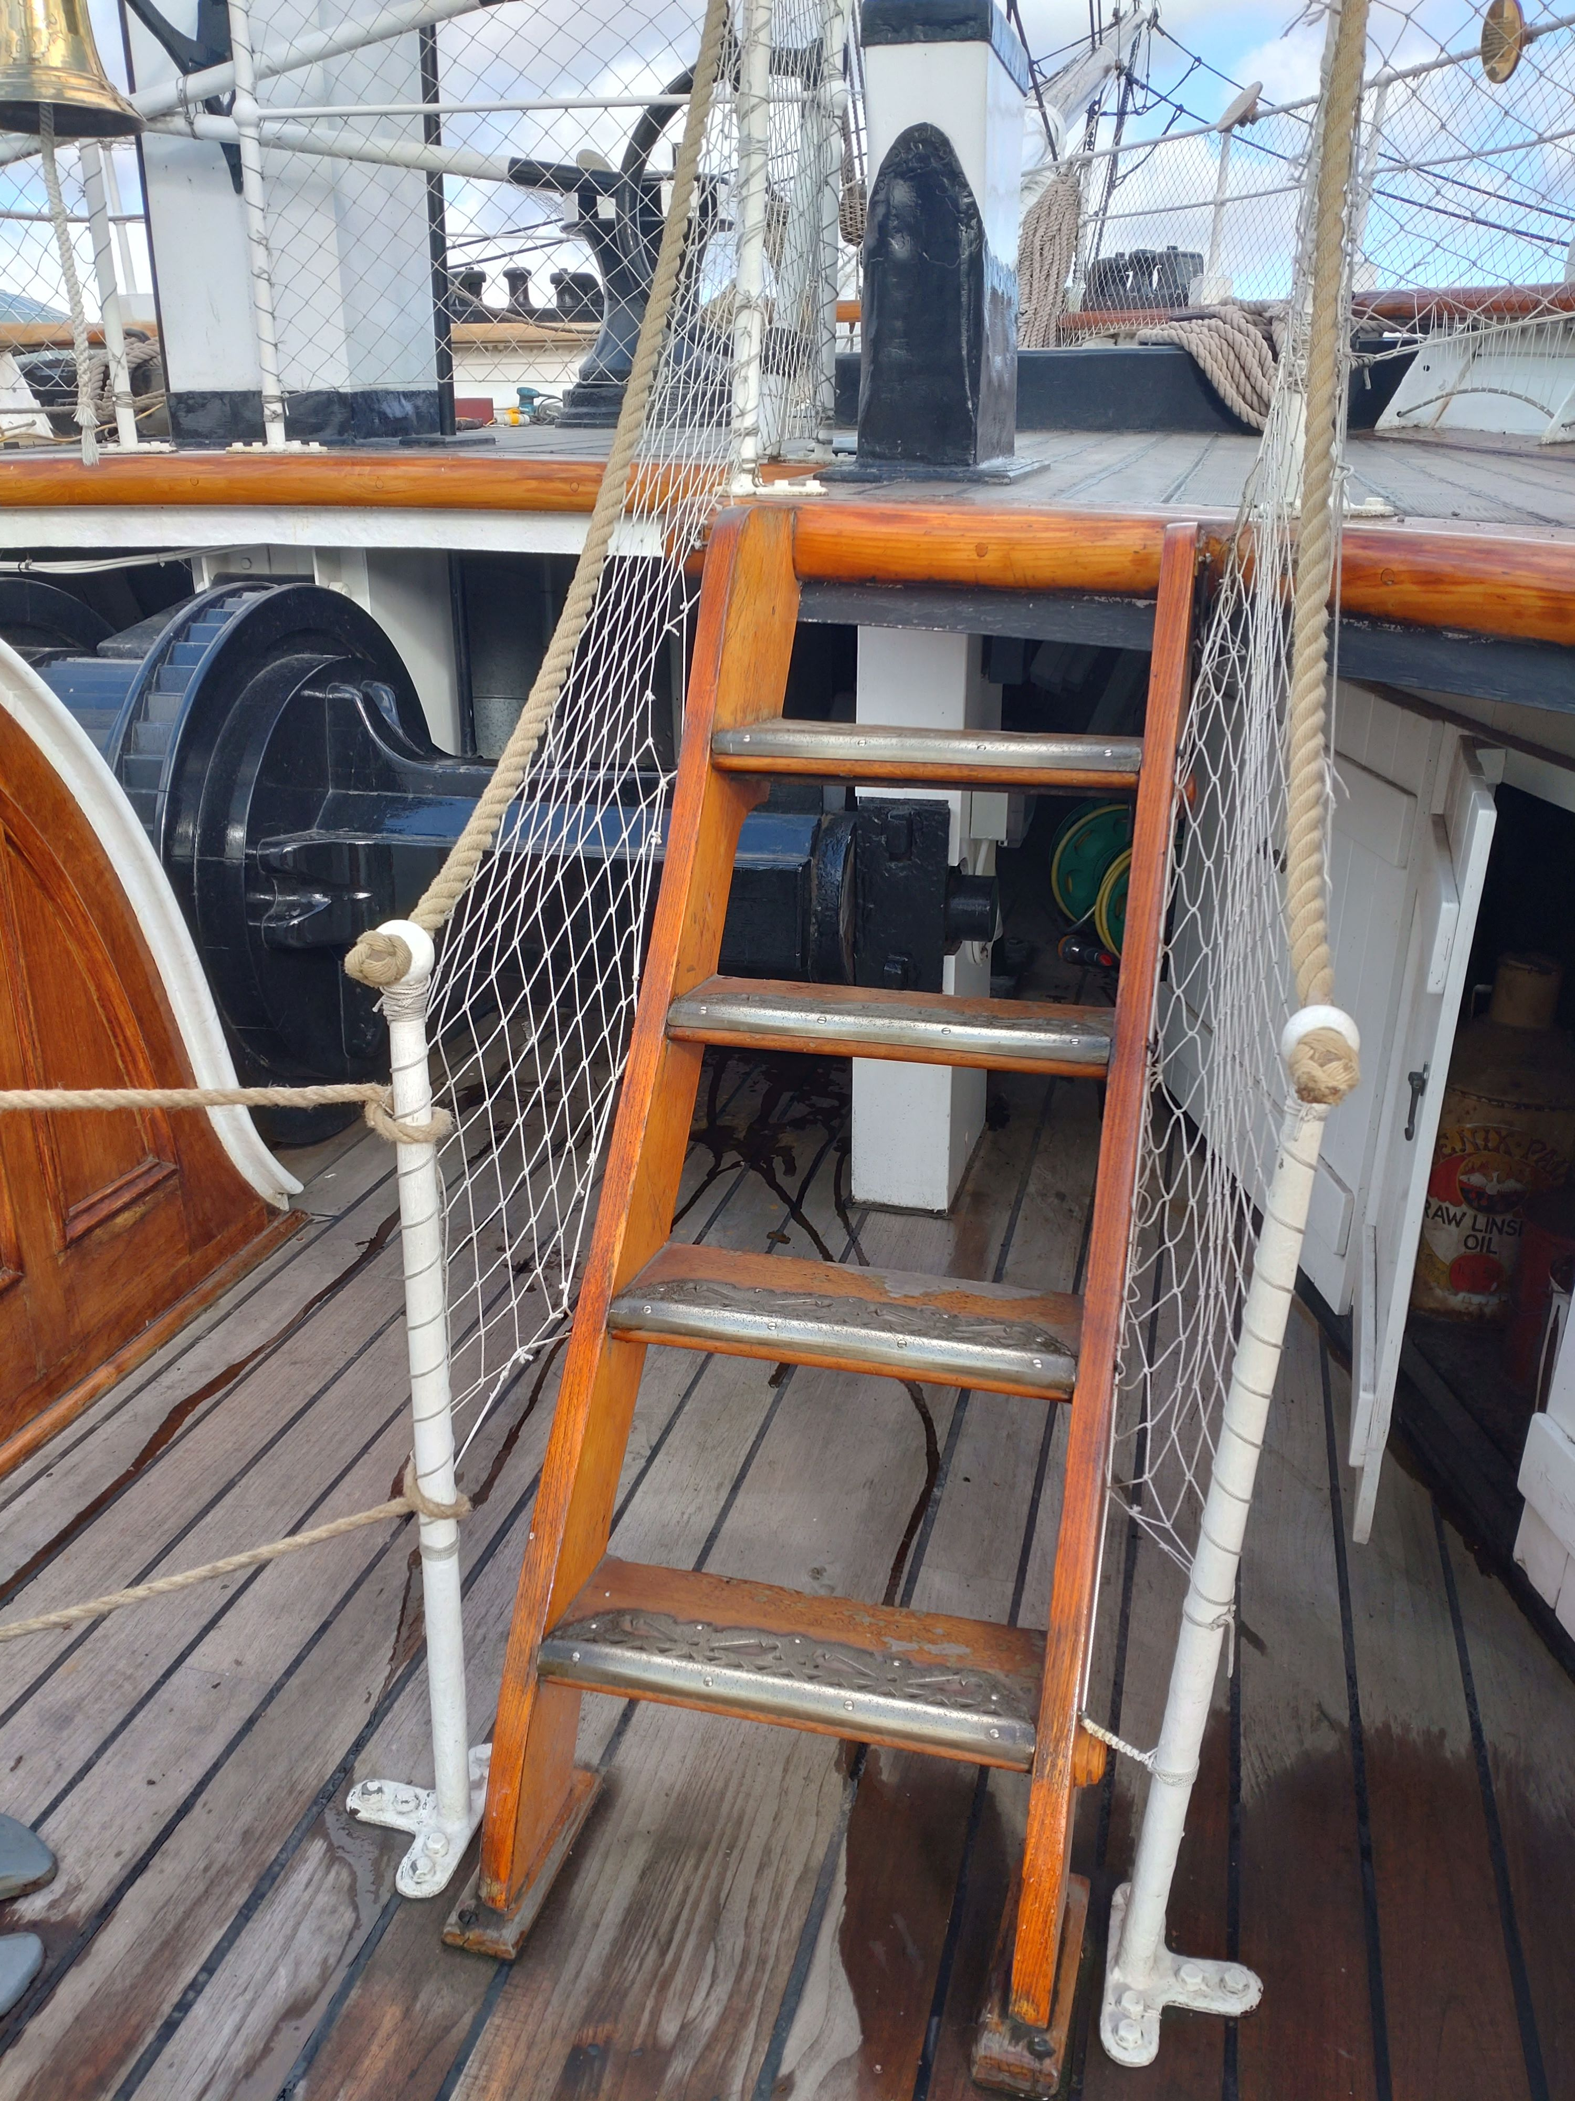
Be careful on the steep stairs

Slide 11
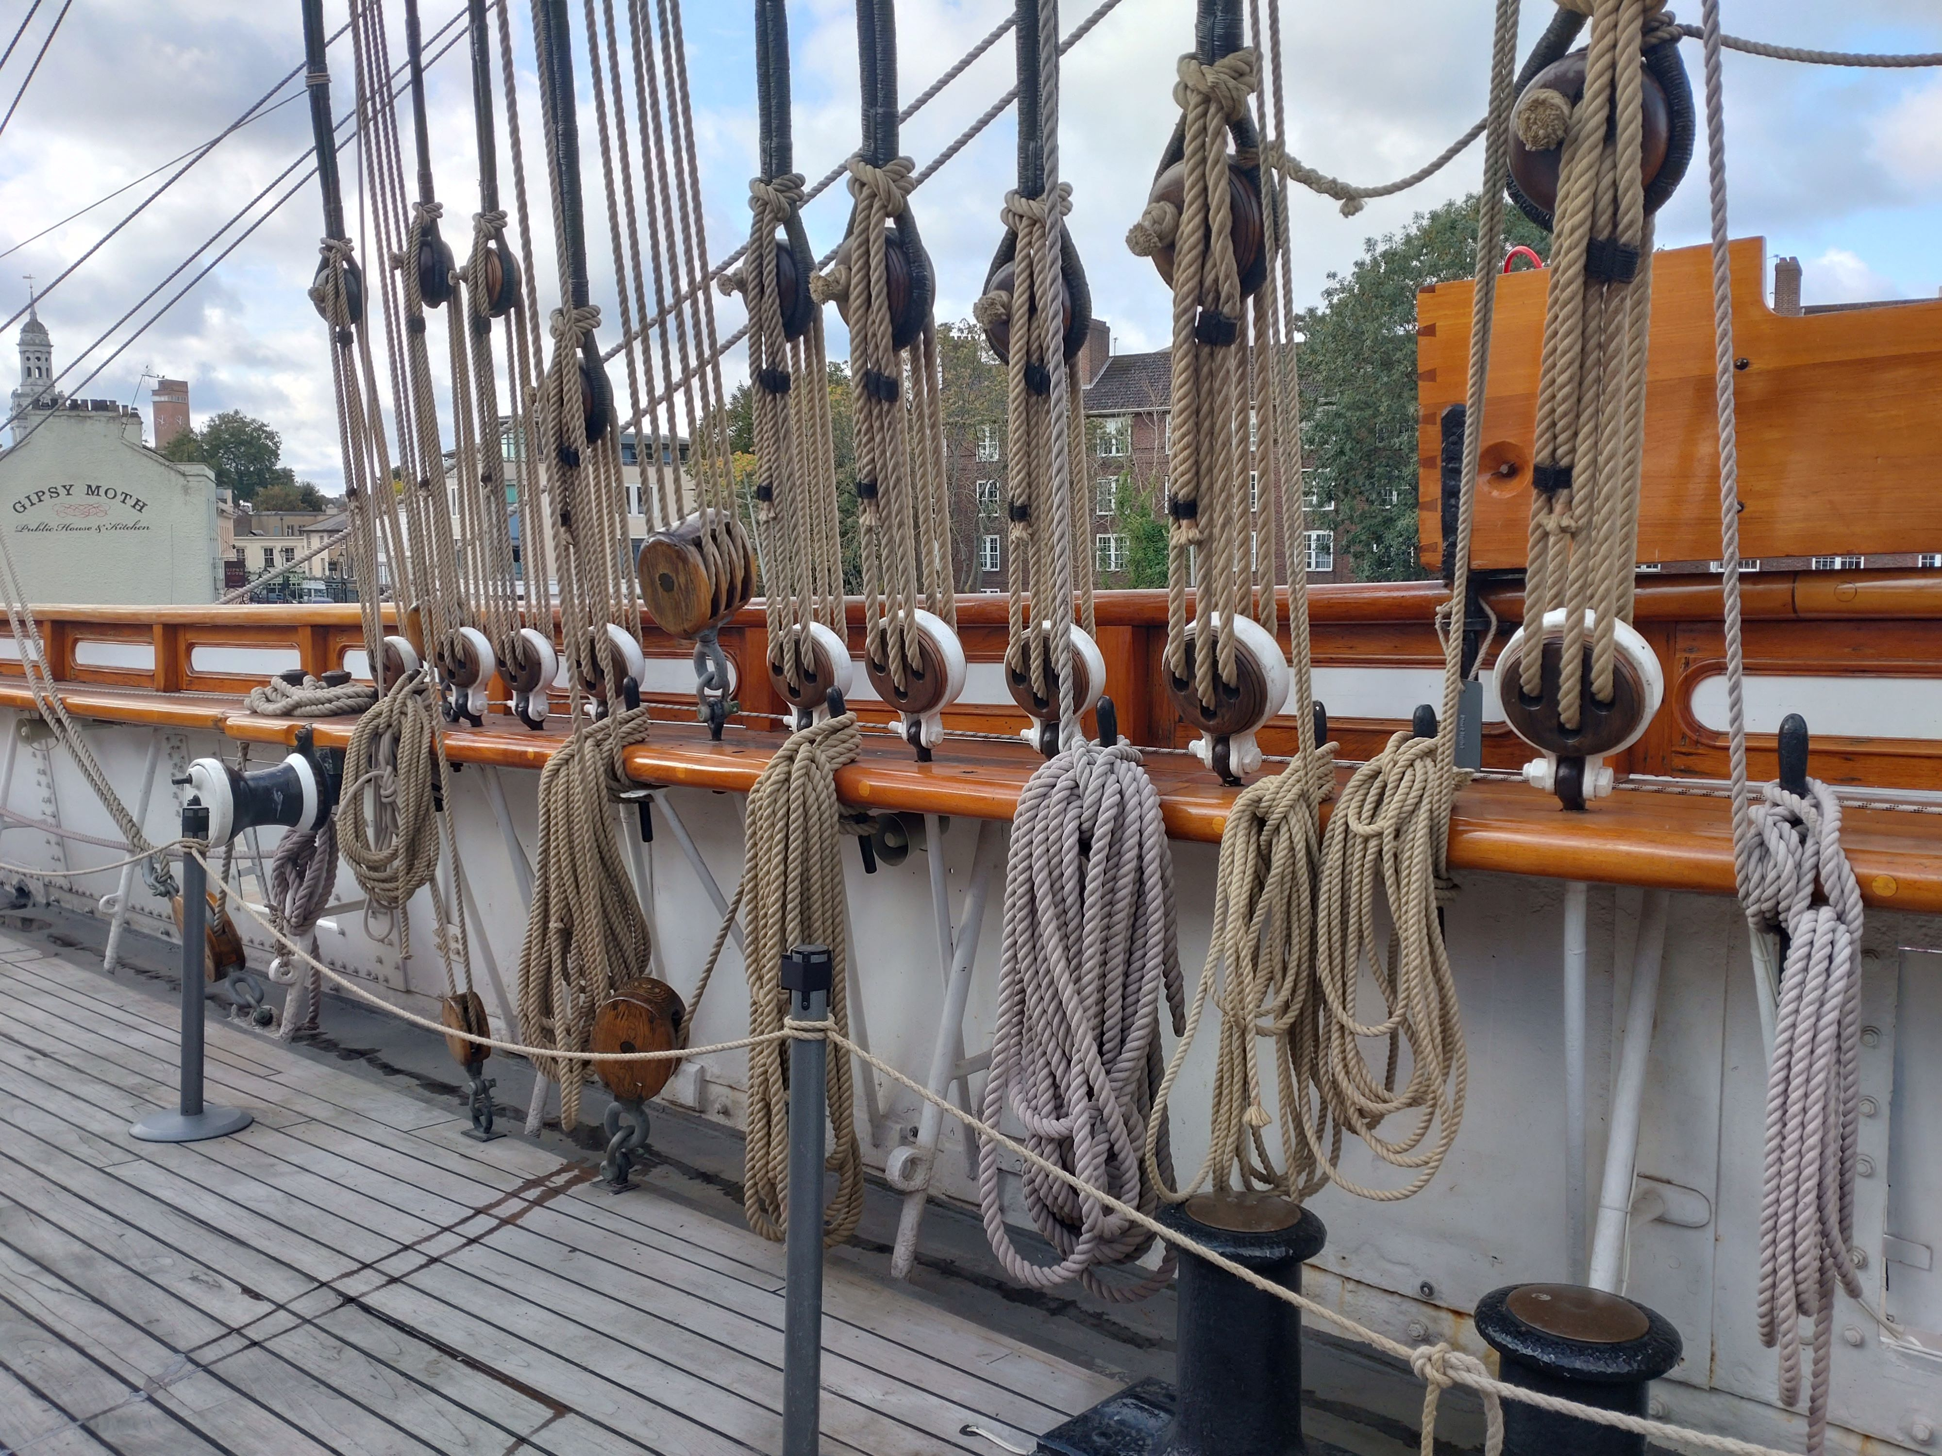
You may try out some jobs that sailors used to do

Slide 12
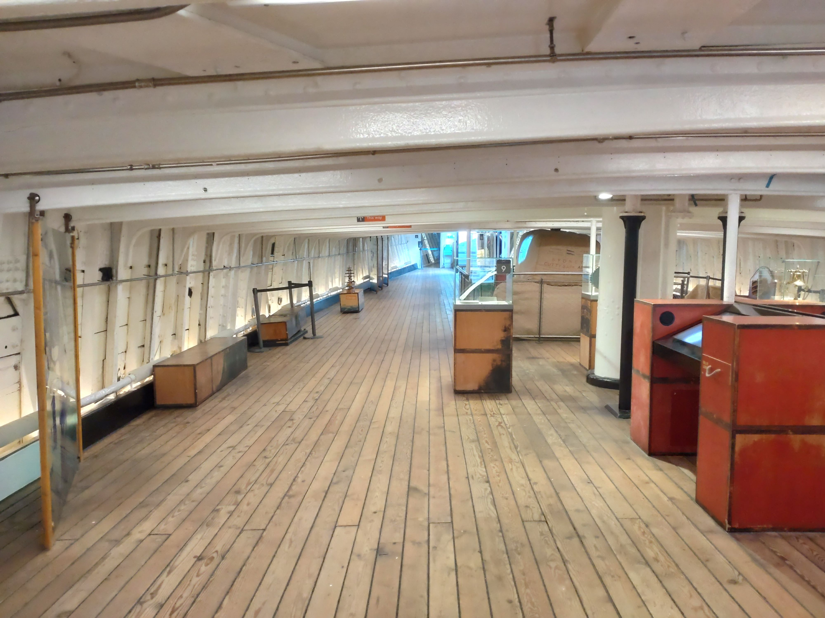
You will explore the 'Tween Deck

Slide 13
Once you have finished your visit, you will collect your things and return to school

