Slide 1
Sample social story for schools
You can use this social story to help young people transition before and during a visit to the National Maritime Museum.
The slides give multiple examples of activities and spaces you may visit, feel free to alter this presentation to suit your specific visit (for example, check which entrance you may use for the museum and remove the alternative slides).
From time to time our galleries need to undergo maintenance and we regularly update exhibition offerings. If there is a particular gallery or exhibition you are planning to visit and you would like an up-to-date image, please contact our Learning team (learning@rmg.co.uk) who can provide assistance.

Slide 2
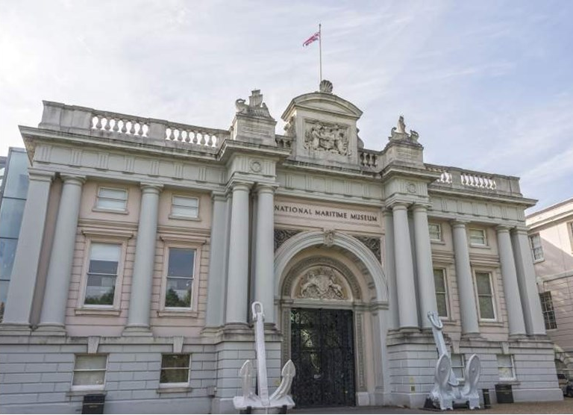
We are going to visit the National Maritime Museum in Greenwich

Slide 3
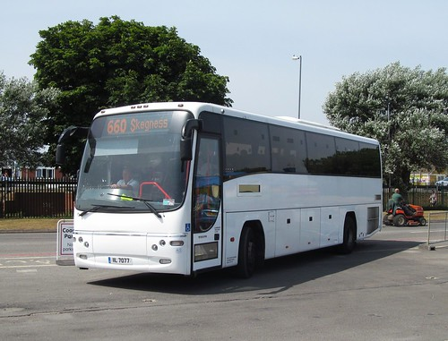
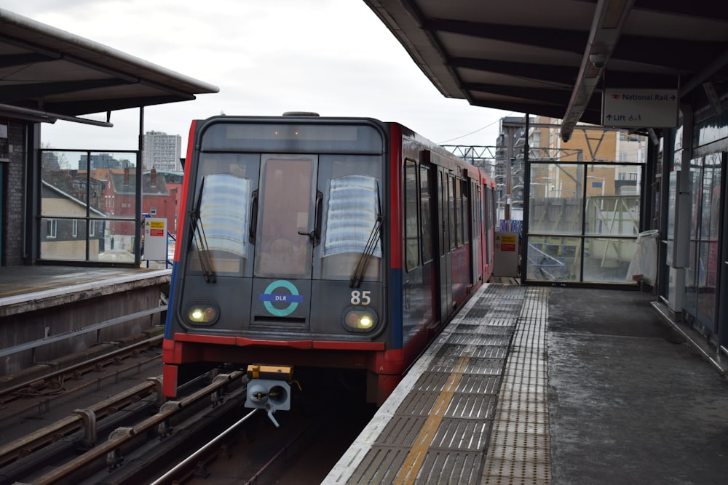
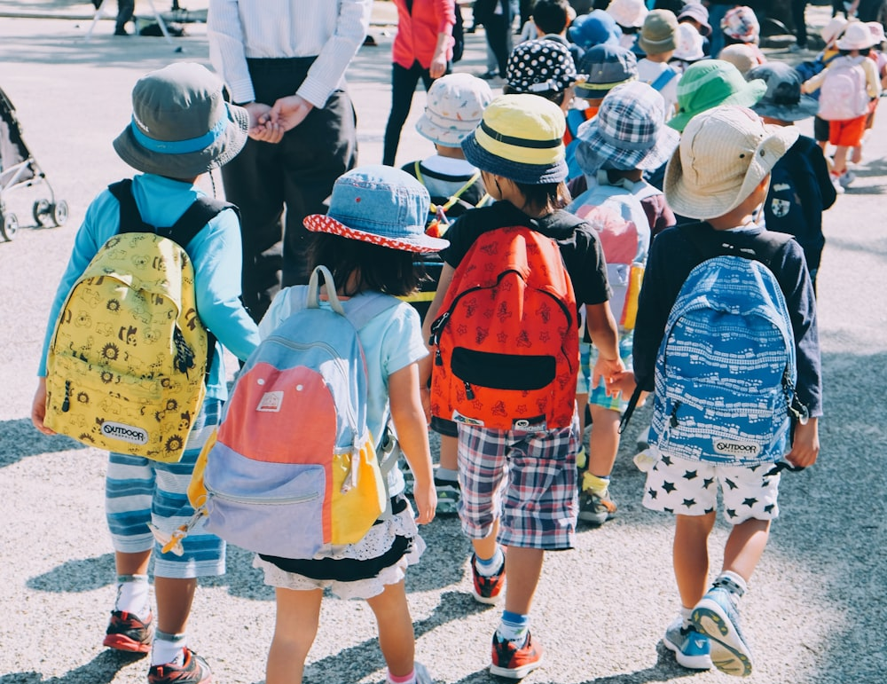
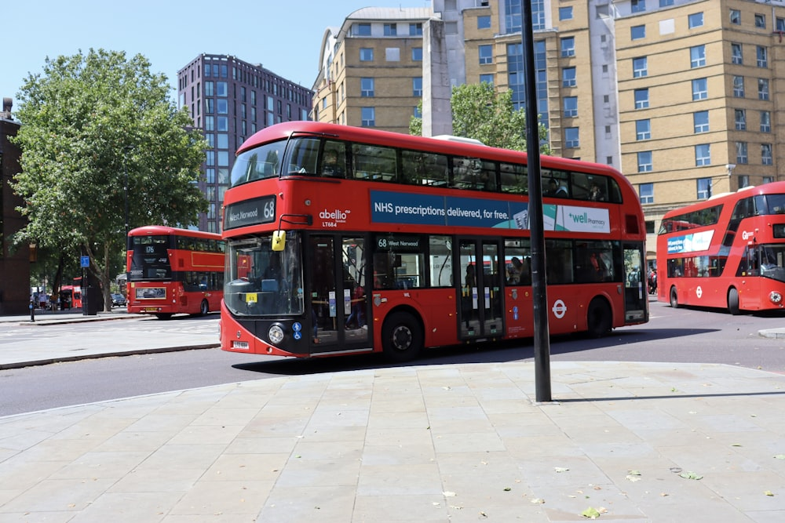
We are going on white buses / on the train / on the bus / we are walking
Notes:
Edit this slide to include your method of transport

Slide 4
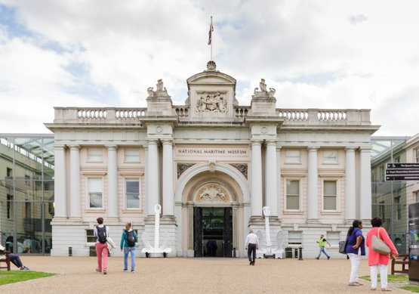
This is the entrance to the Museum
Notes:
This image shows the Romney Road entrance to the Museum – please check the entrance that you will be using and amend the presentation in advance of your visit.

Slide 5
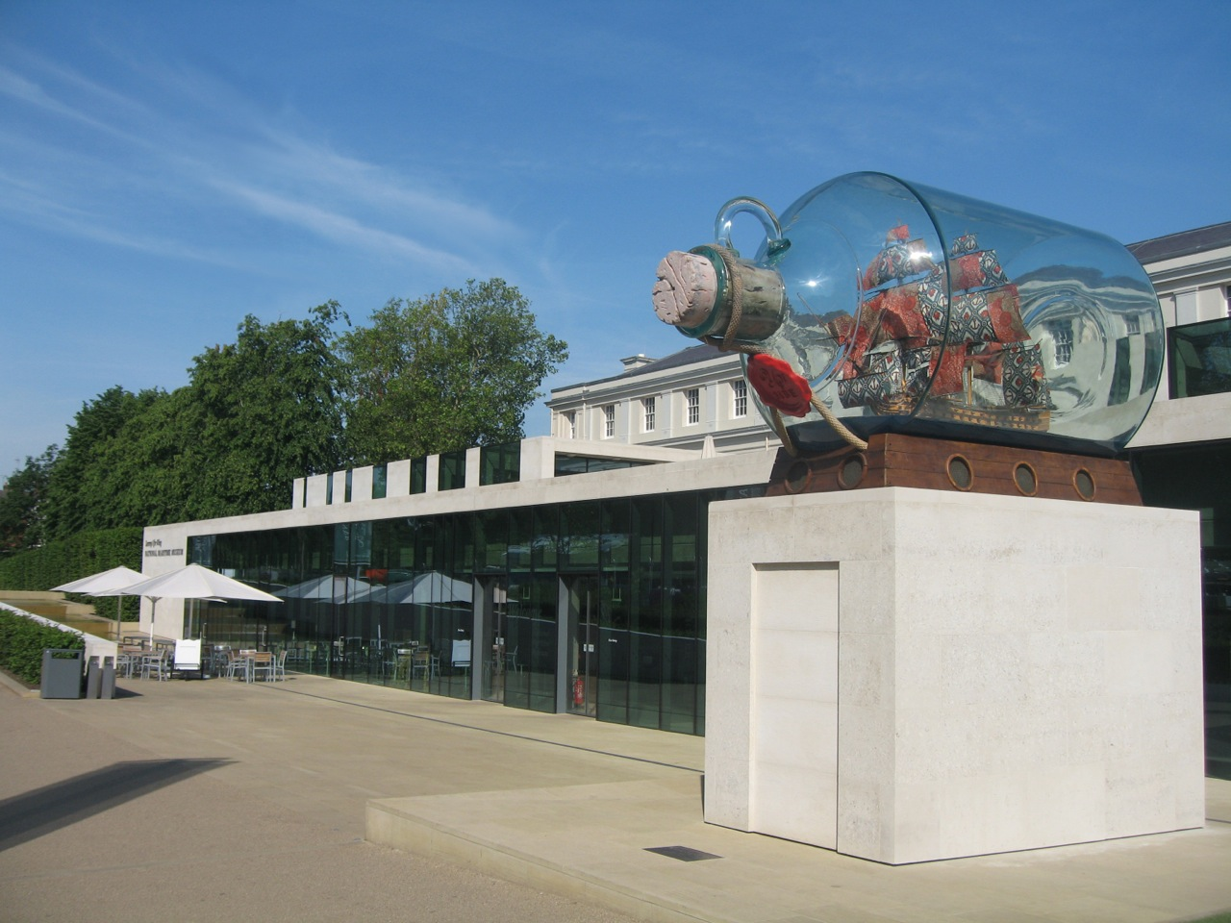
This is the entrance to the Museum
Notes:
This image shows the Parkside entrance to the Museum – please check the entrance that you will be using and amend the presentation in advance of your visit.

Slide 6
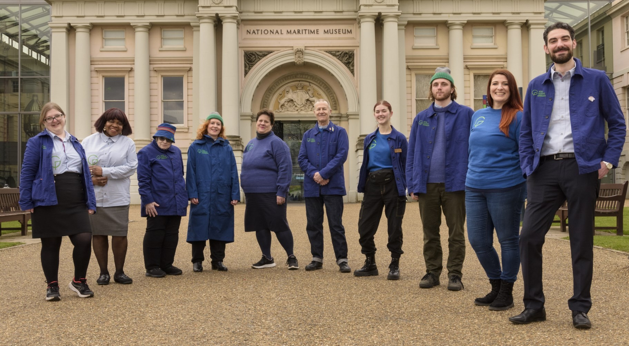
The people who work at the museum wear blue

Slide 7
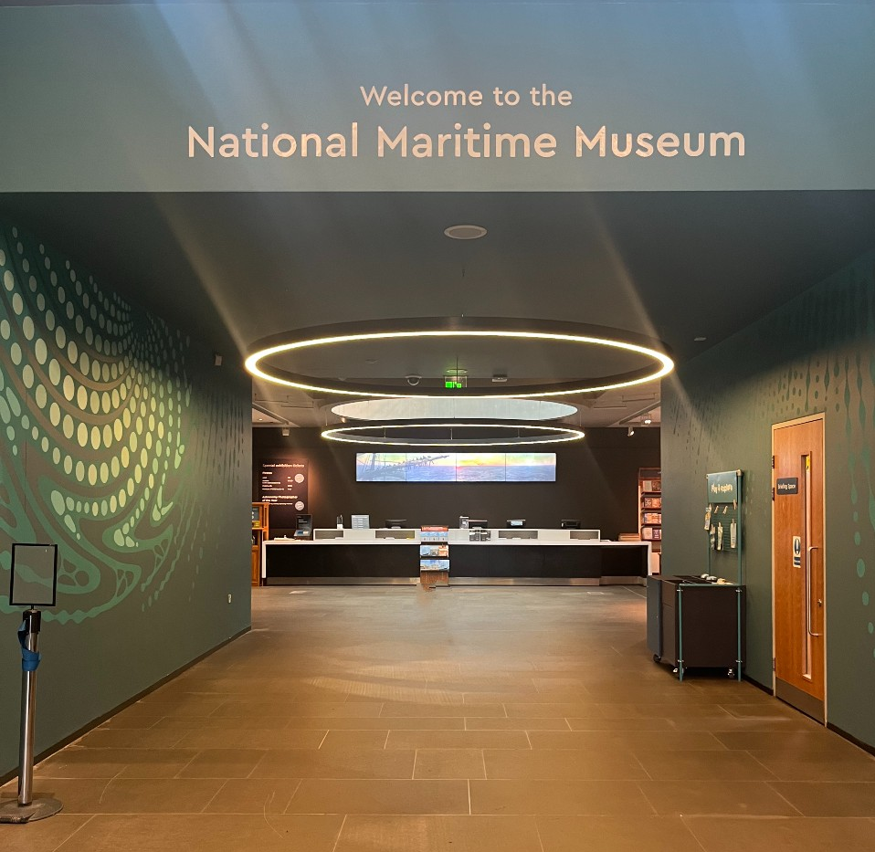
The inside of the Museum is also blue!

Slide 8
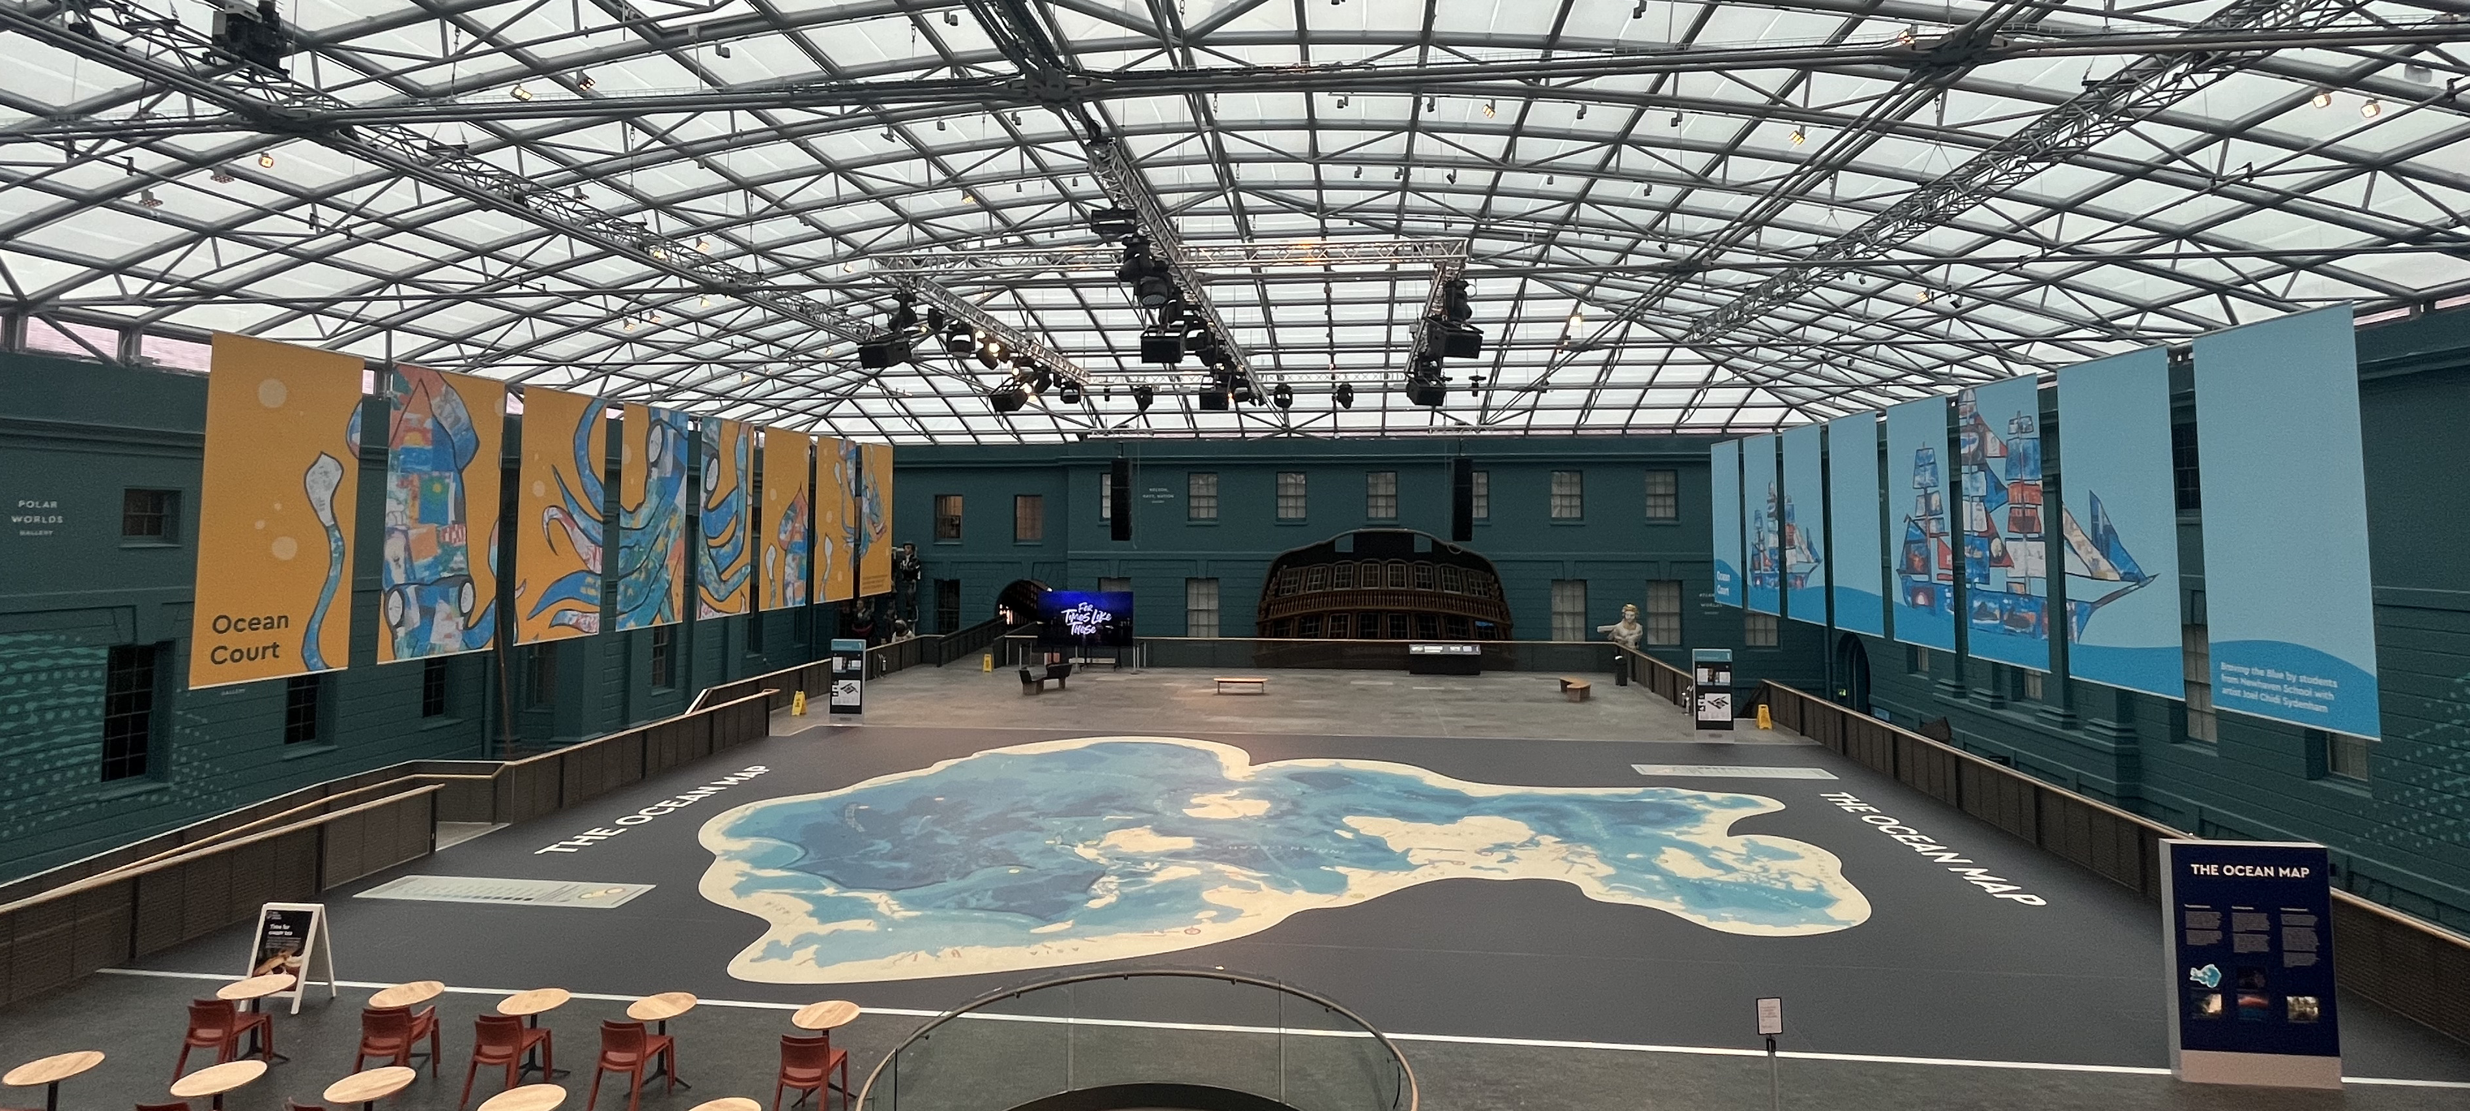
The National Maritime Museum is a big place
This is the Ocean Map

Slide 9
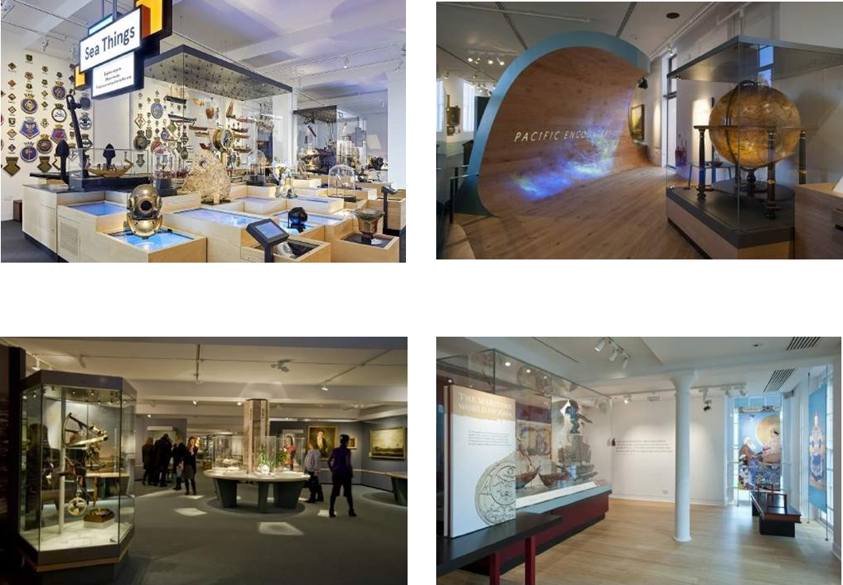
There are lots of things to see at the Museum

Slide 10
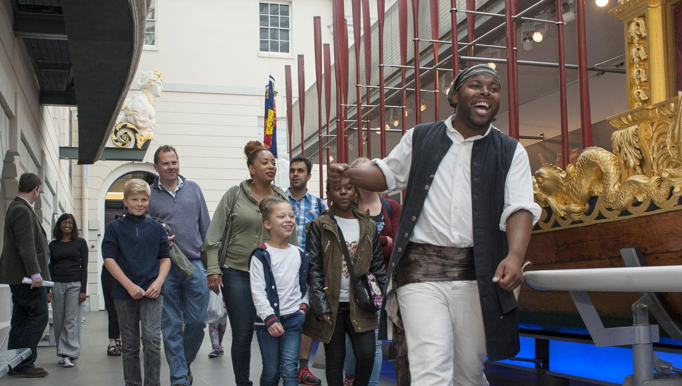
We will walk through the Museum together

Slide 11
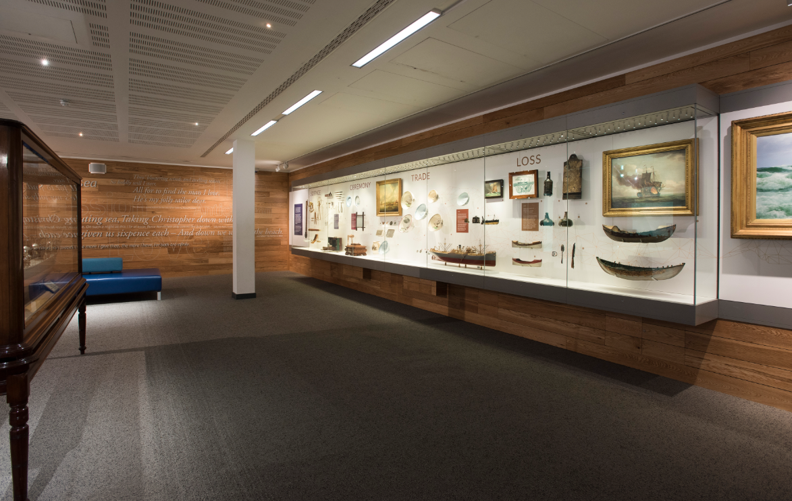
We will visit the Voyagers gallery
Notes:
Options to add images/text of different galleries here

Slide 12
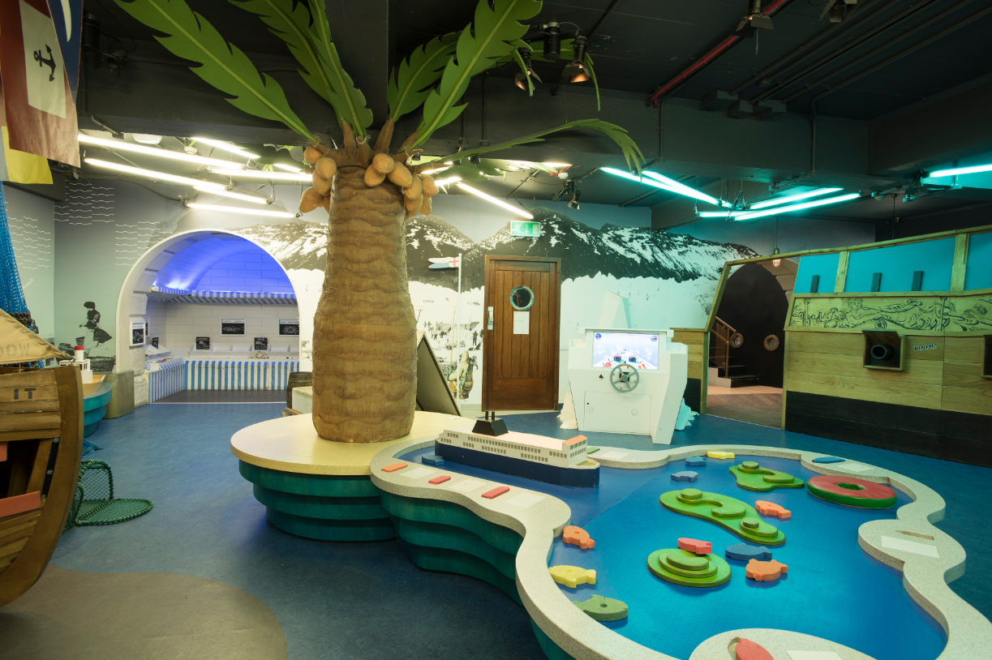
We can play in the Ahoy Gallery

Slide 13
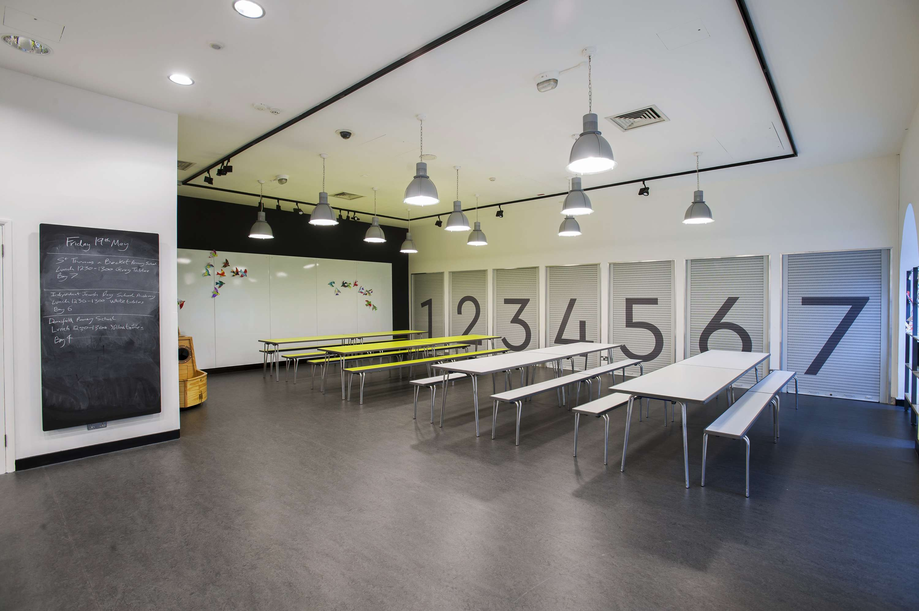
We will have lunch in the Learning Space
Notes:
Please use the relevant slide, if you have a lunch space booked this will be confirmed in advance of your visit.

Slide 14
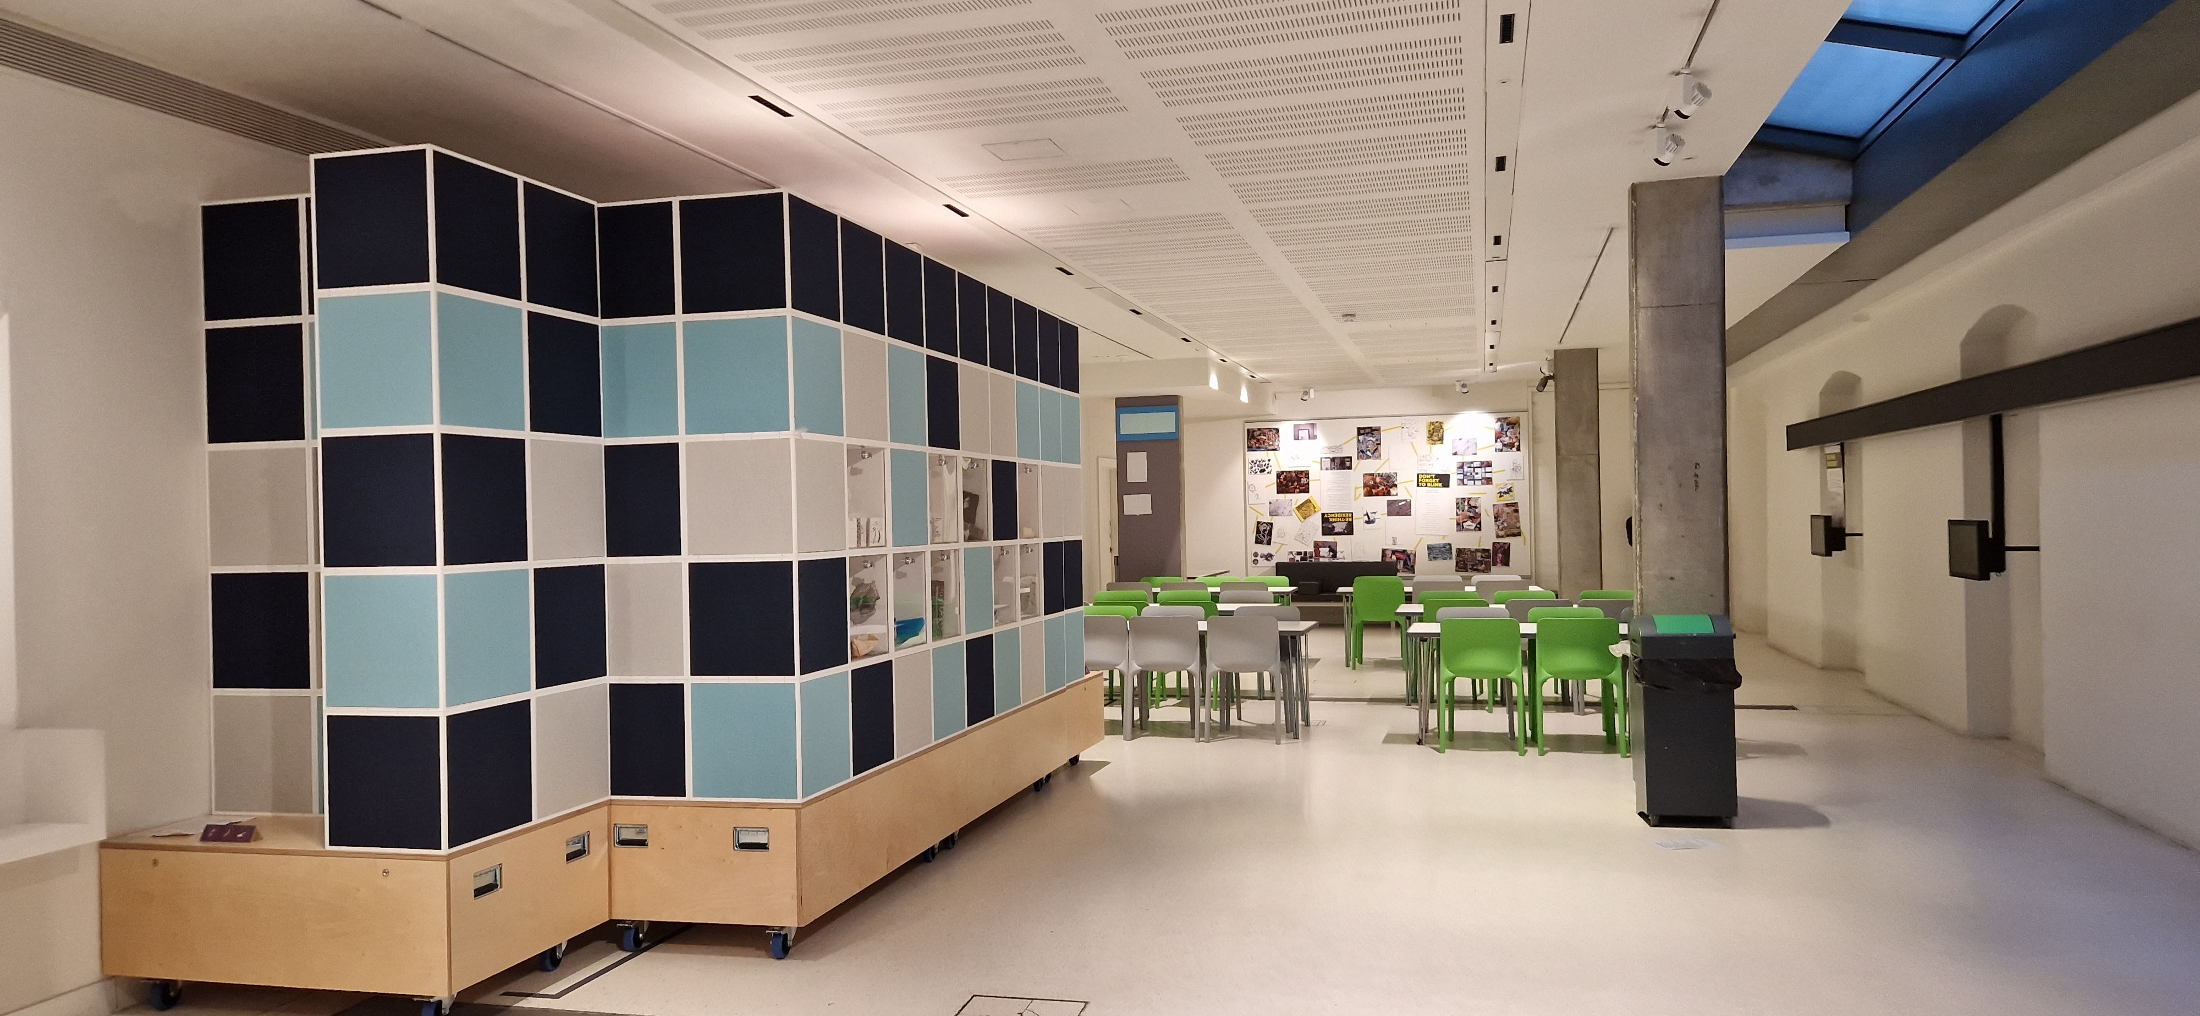
We will have lunch in the Rethink space
Notes:
Options to add images/text of different galleries here

Slide 15
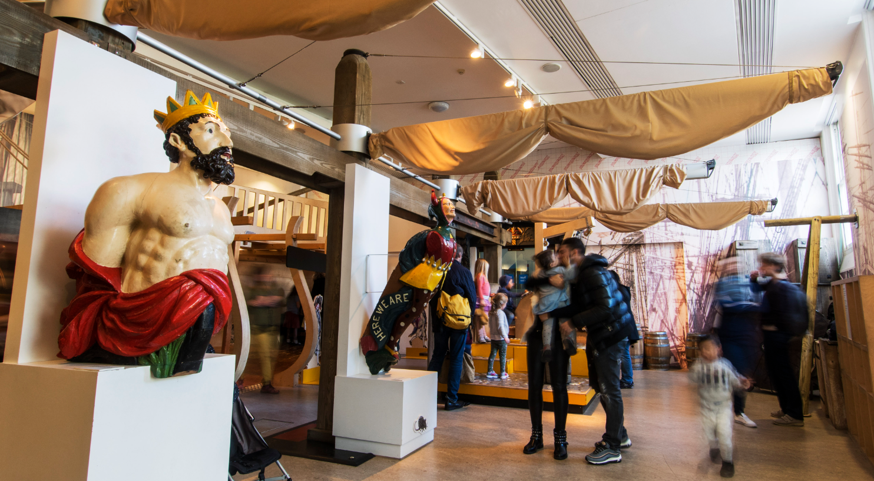
We can play in the All Hands Gallery
Notes:
Please amend the play space as appropriate and relevant for your visit

Slide 16
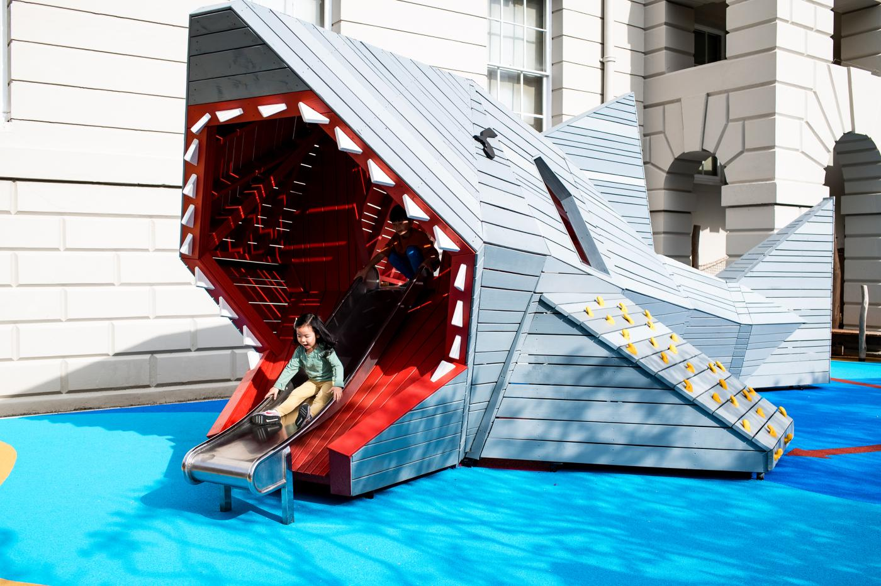
We can play in the Cove playground

Slide 17
We can play on the Ocean Map

Slide 18
Then it will be time to get back on the bus...

Slide 19
...and come back to school.
Replace this with an image of your school

